Slide 1
Politics and Government of Nepal(PS505)
Krishna P. Dhakal

Slide 2
Unit- I
Foundation and Determinant

Slide 4


Slide 5
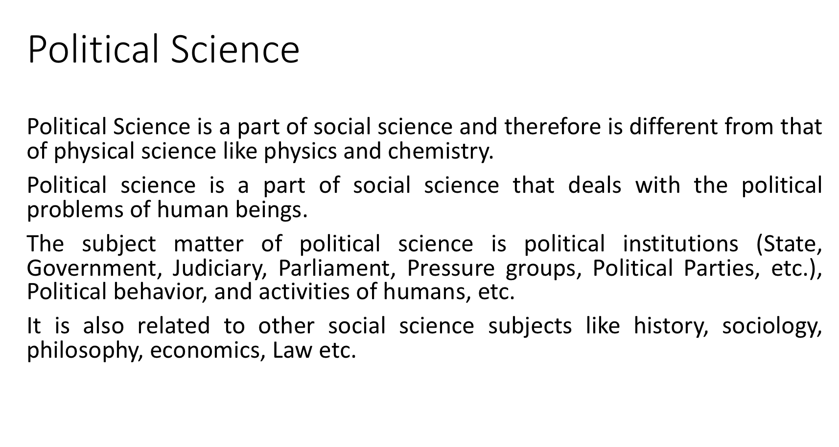

Slide 6
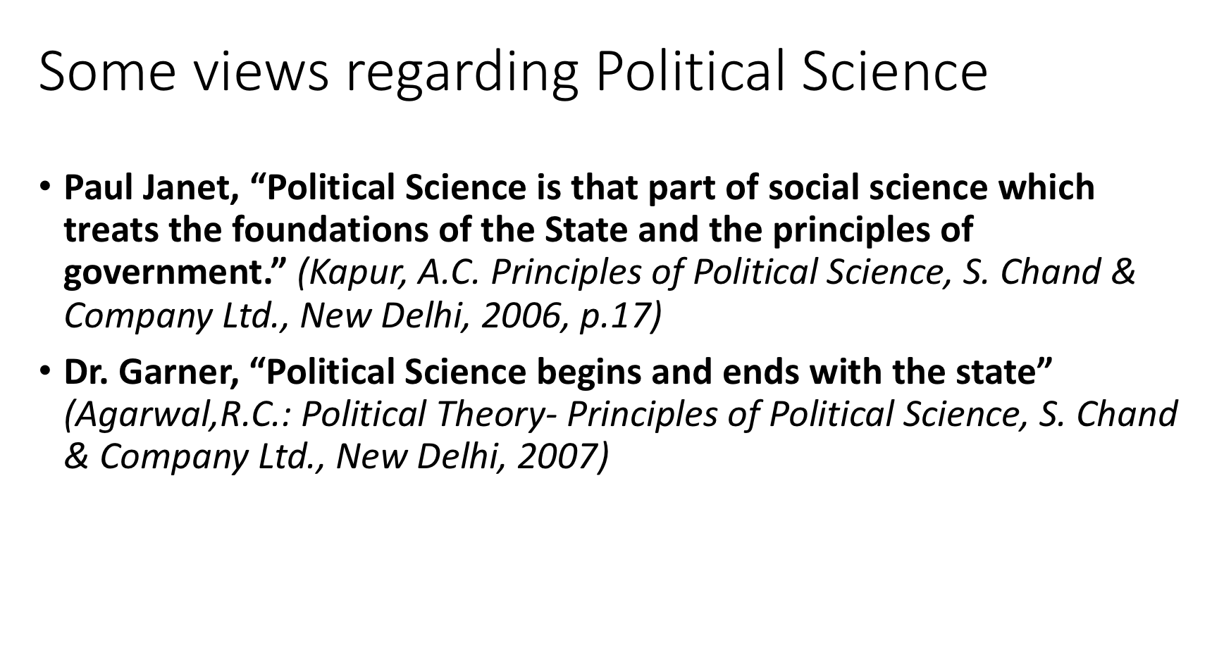

Slide 7
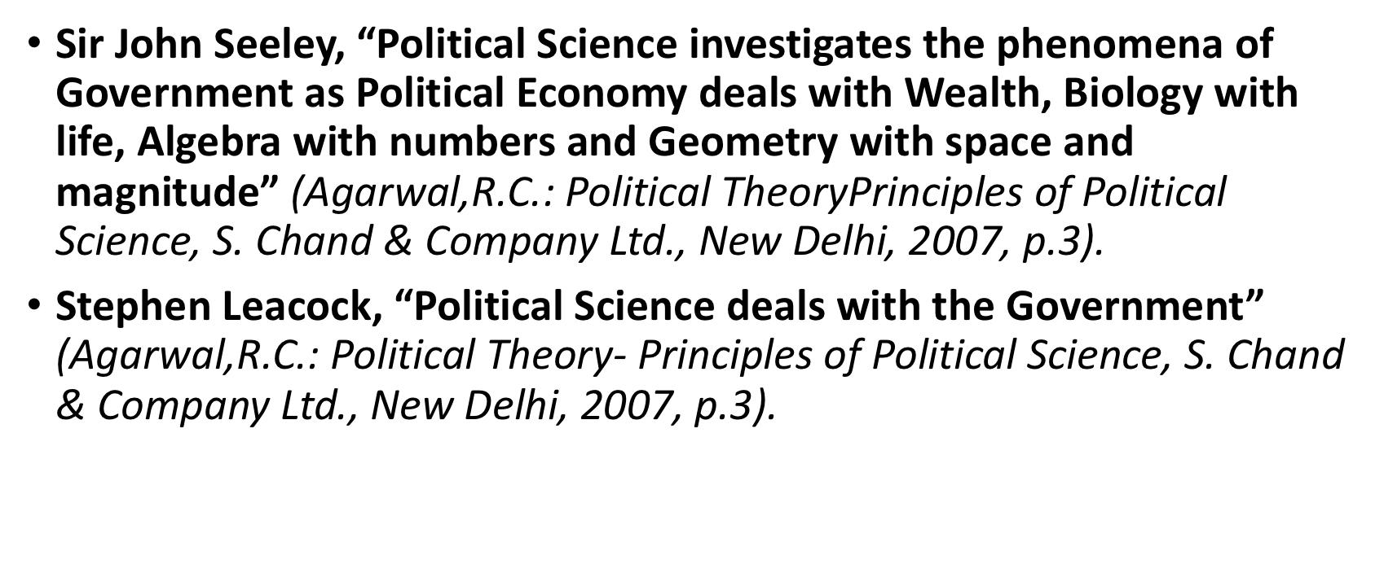

Slide 8
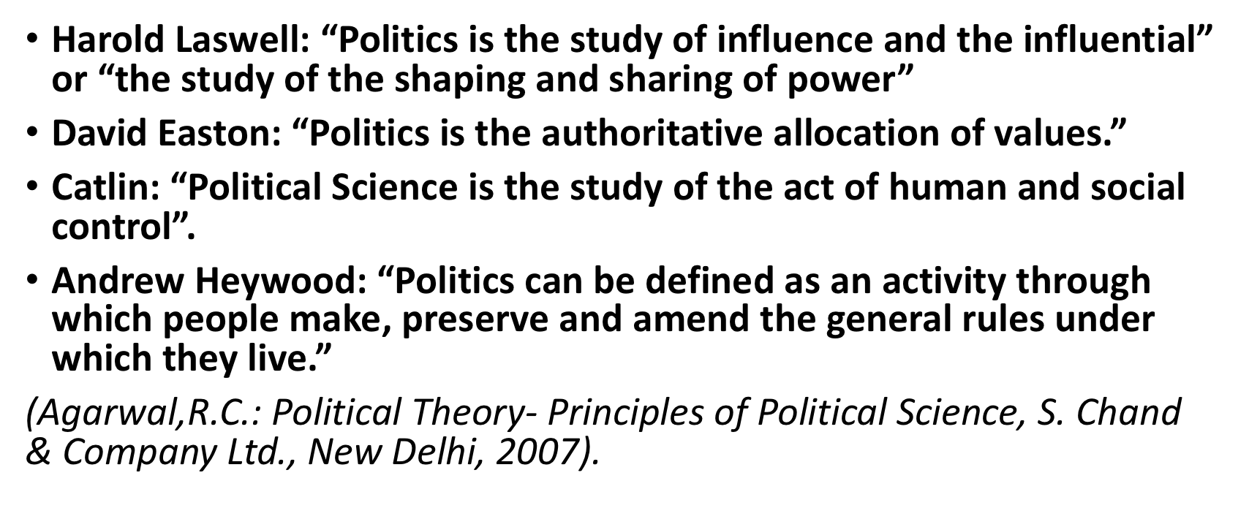

Slide 9
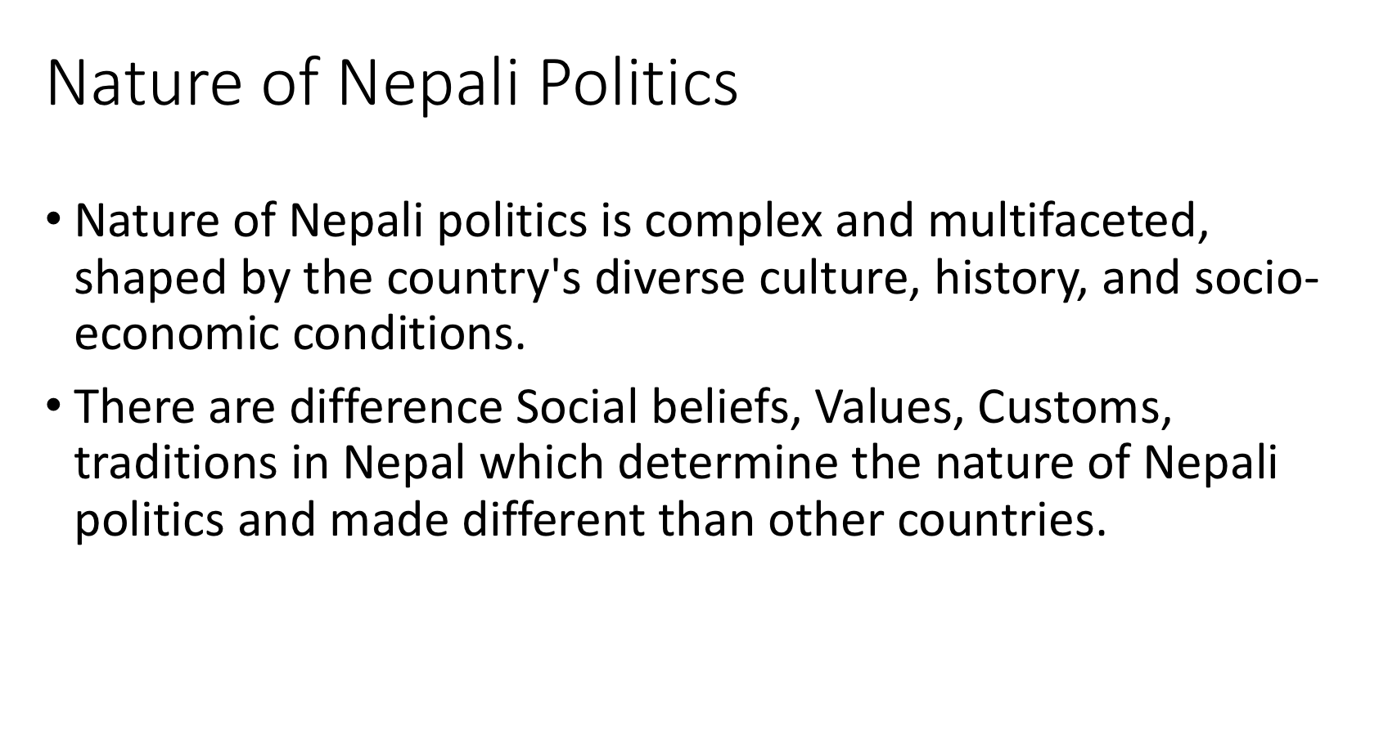

Slide 10
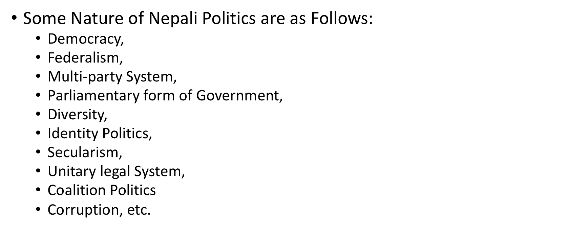

Slide 11
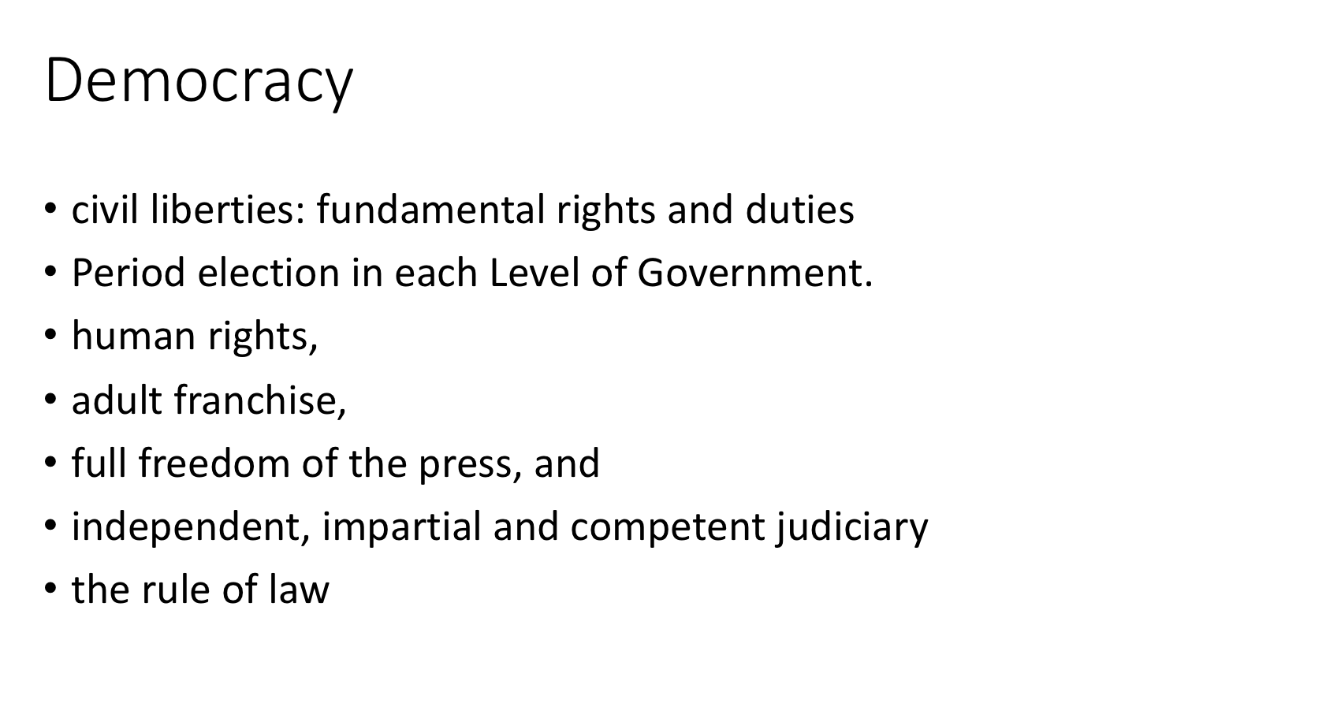

Slide 12
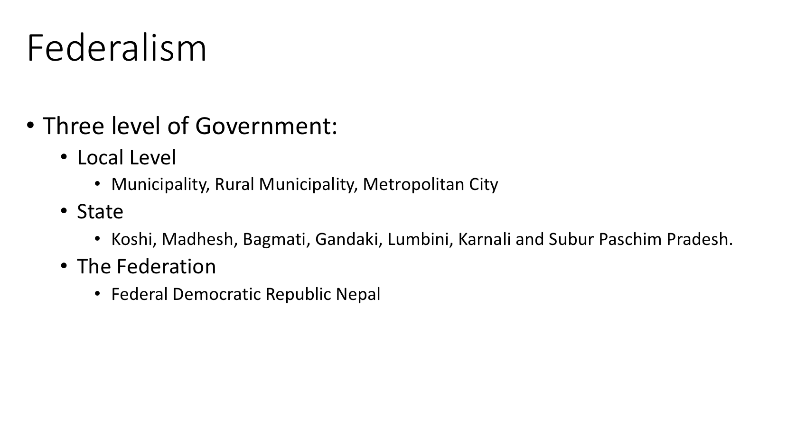

Slide 13
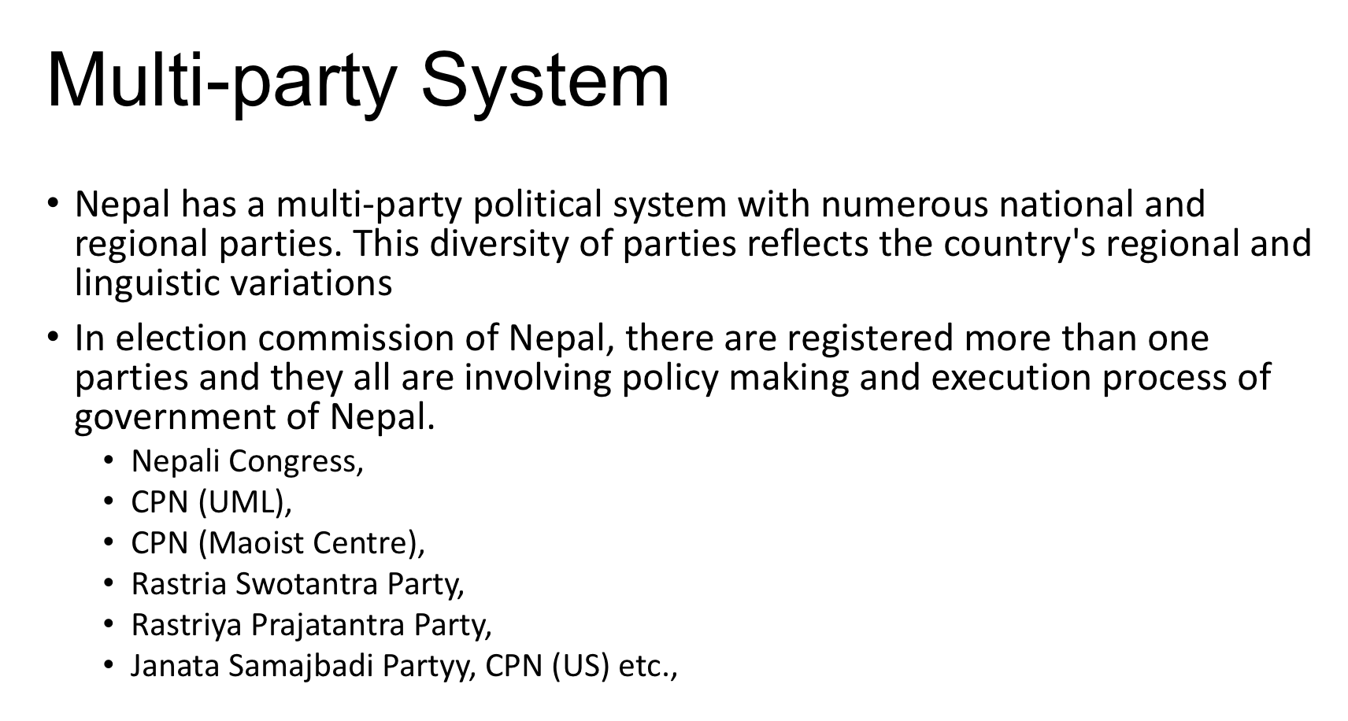

Slide 14
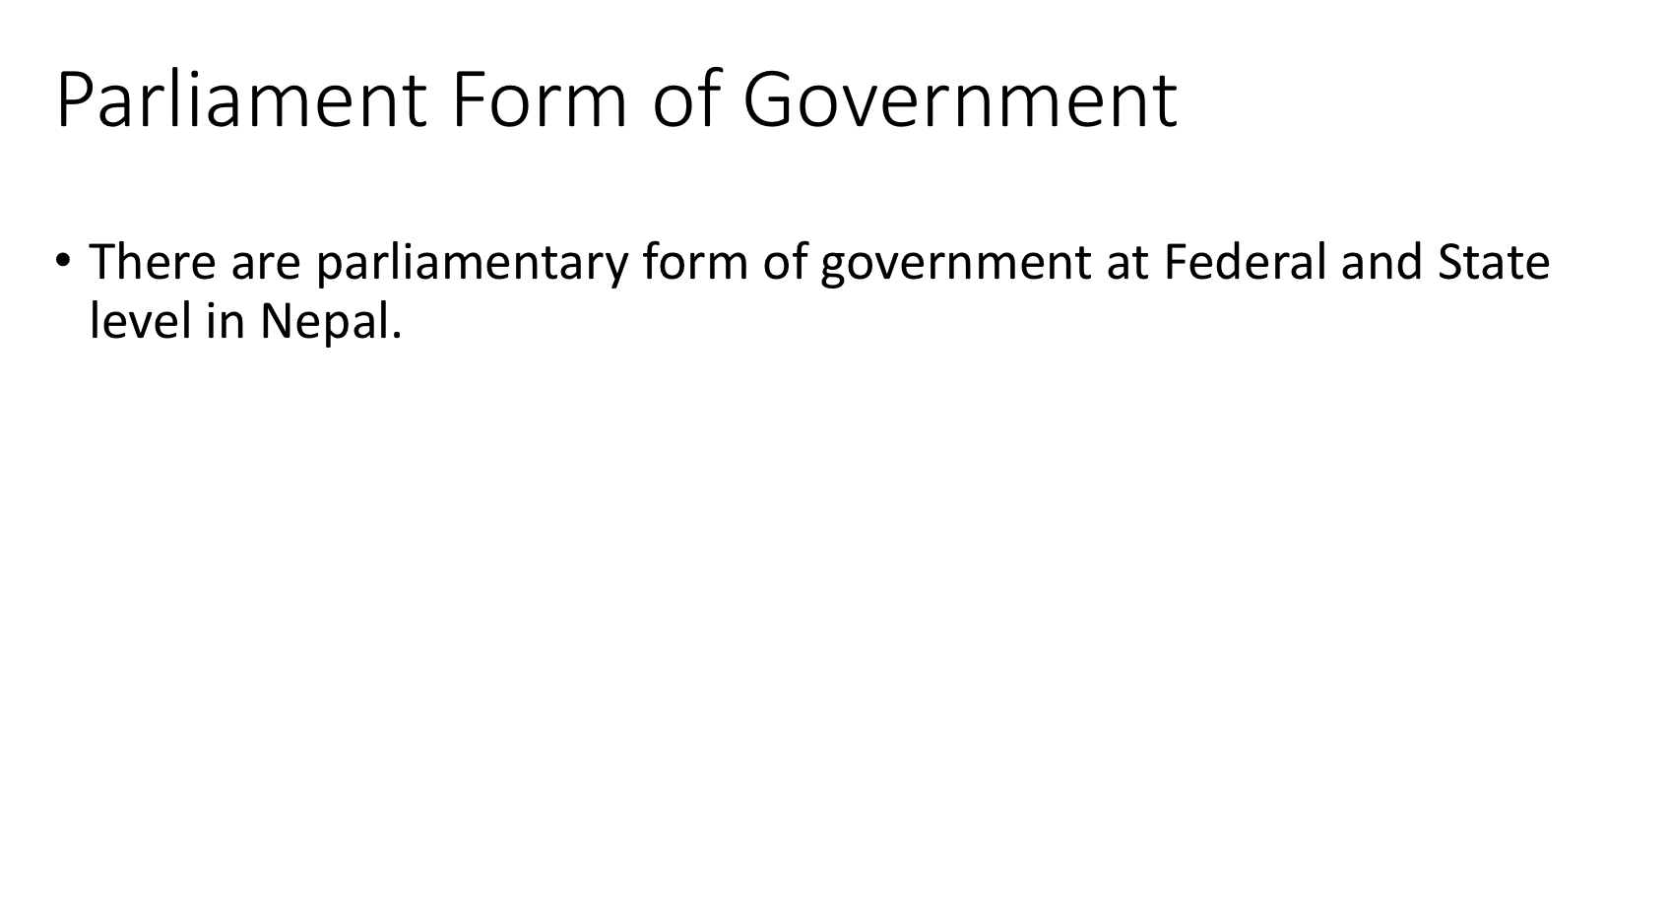

Slide 15
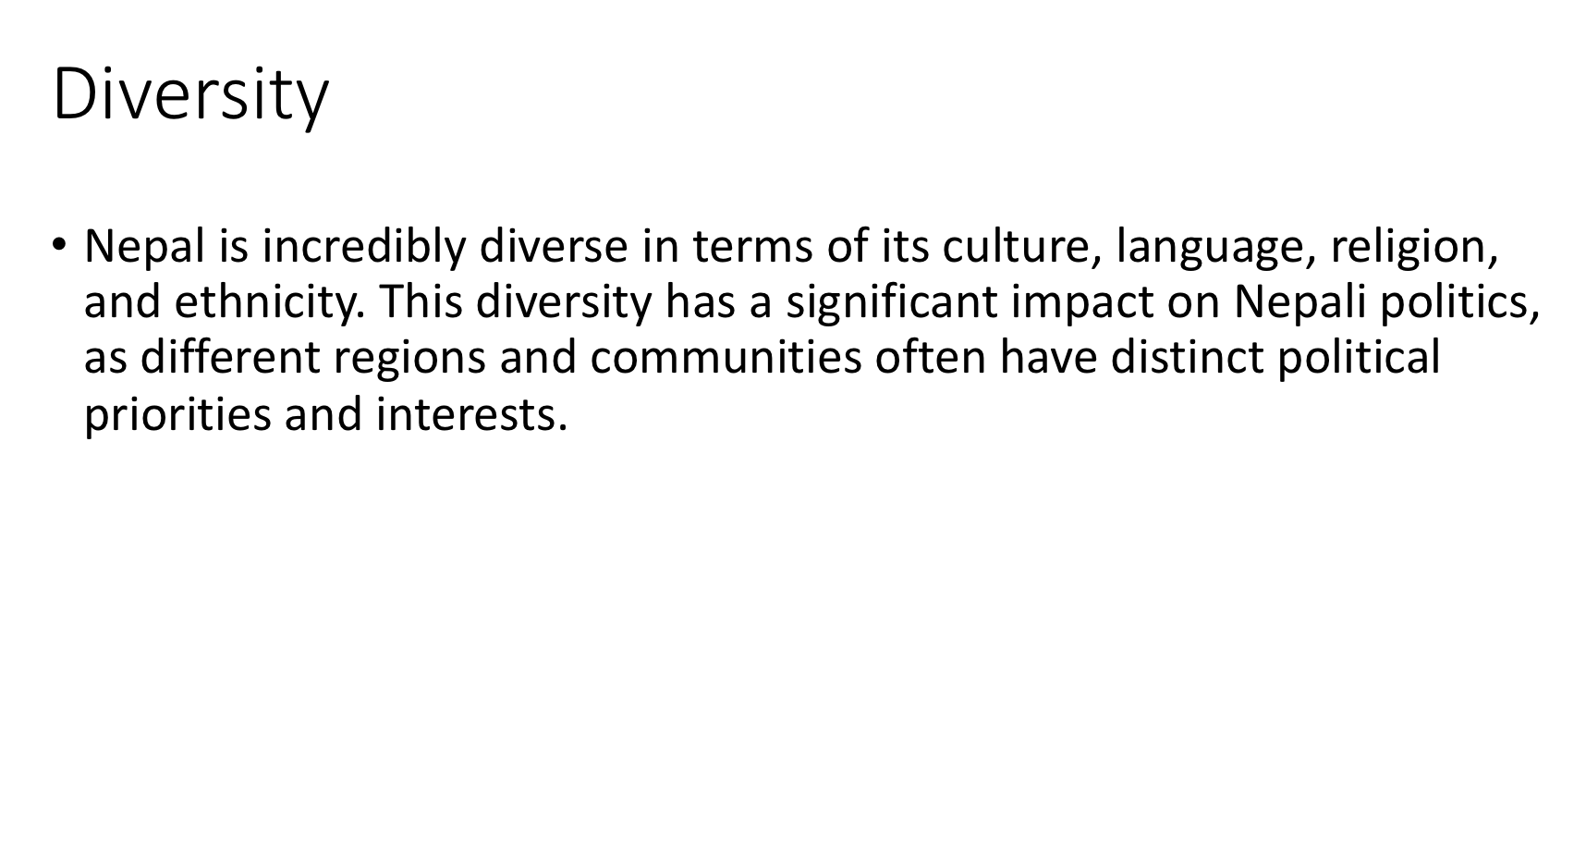

Slide 16
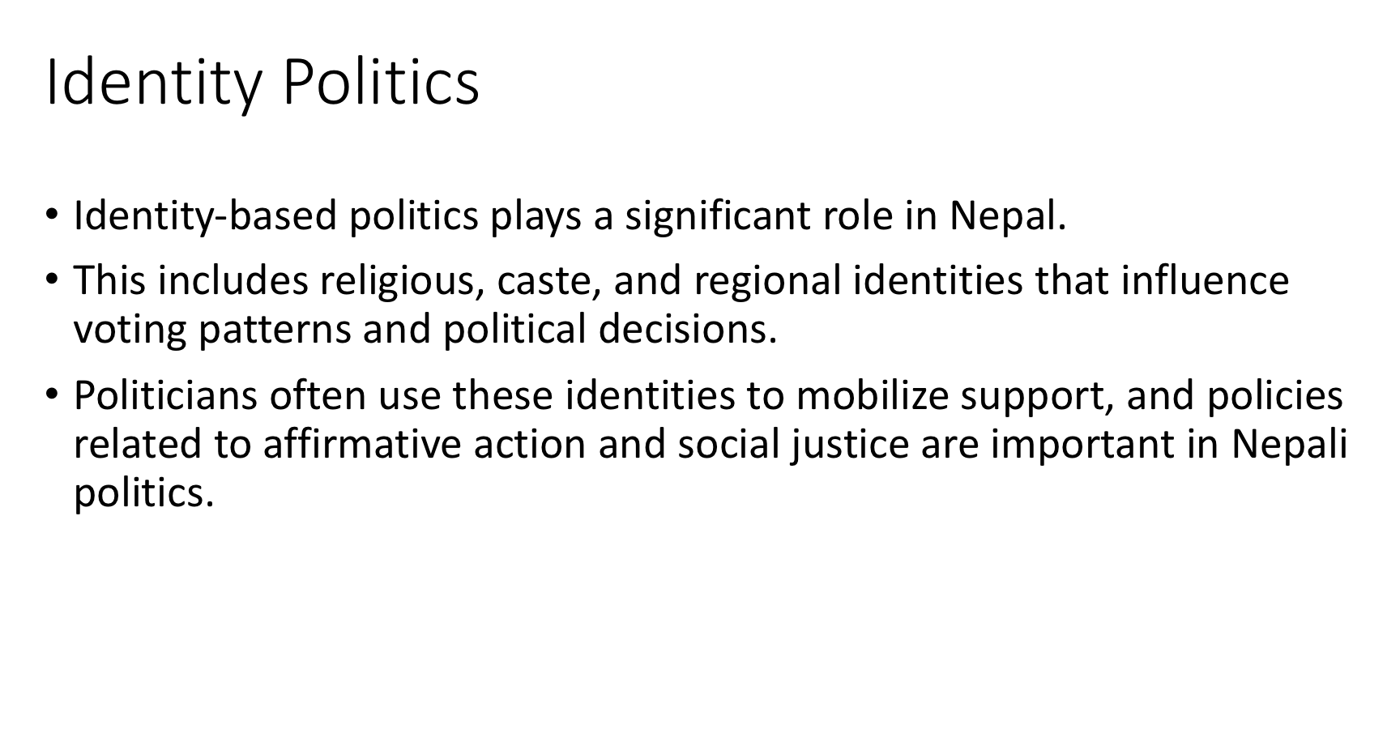

Slide 17
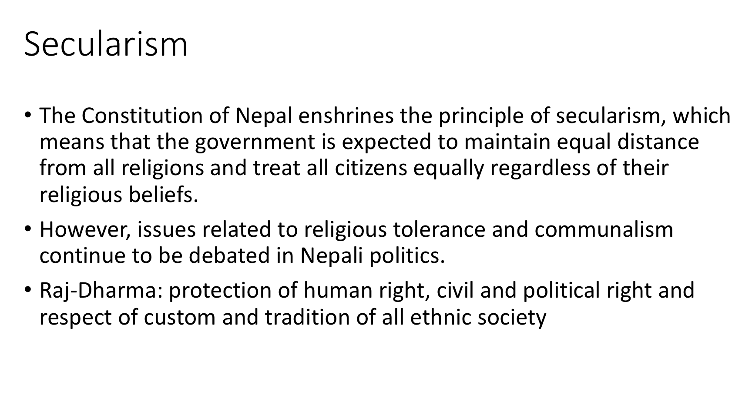

Slide 18
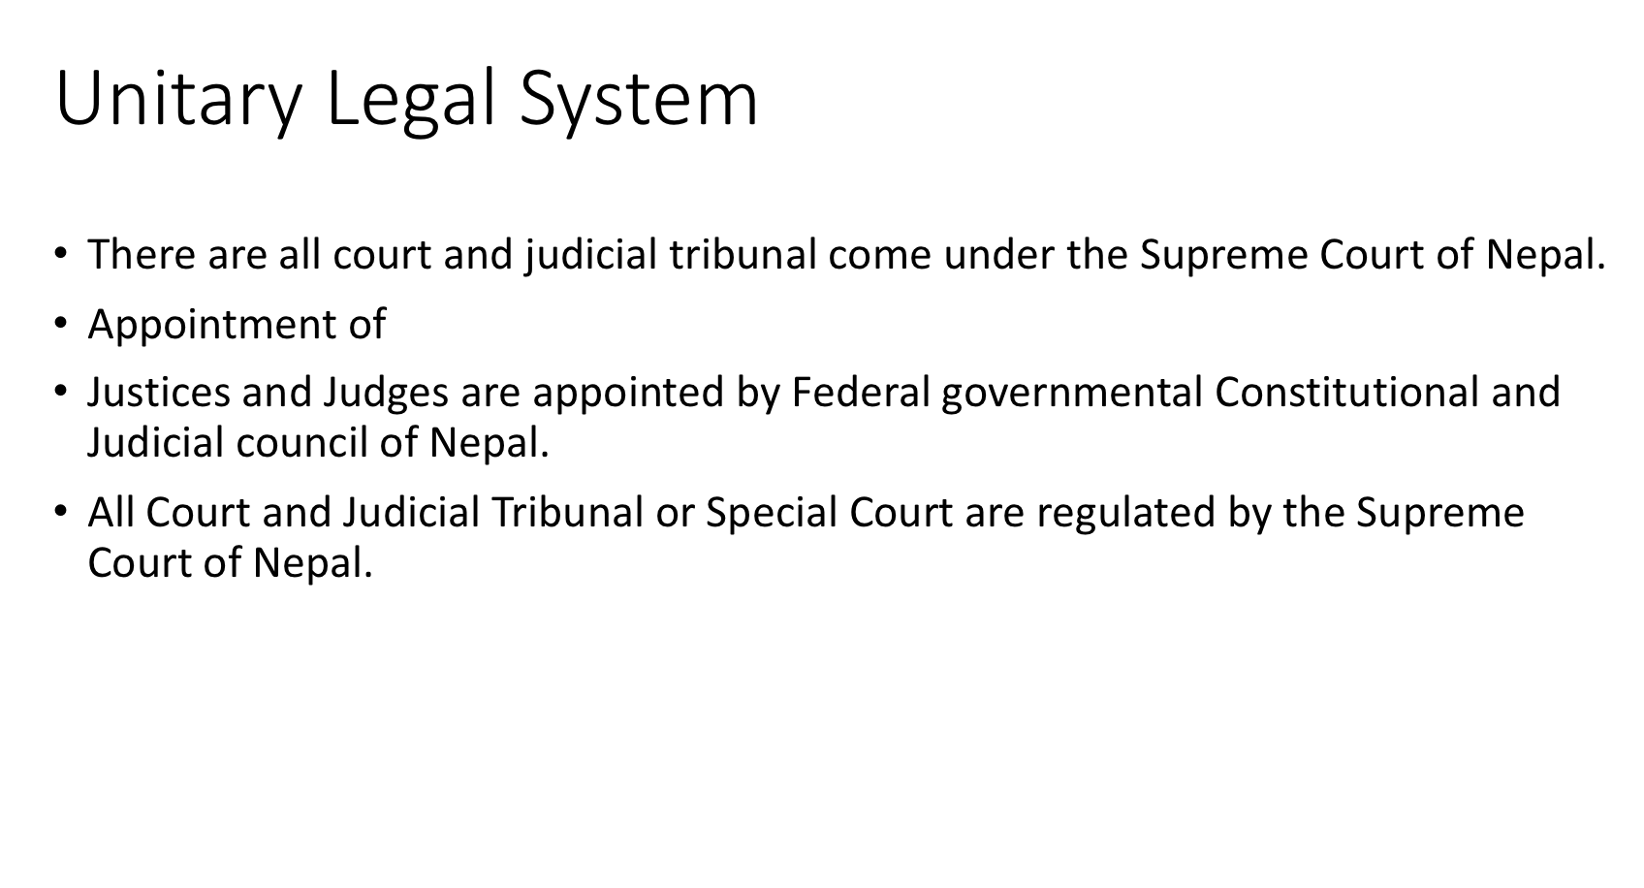

Slide 19
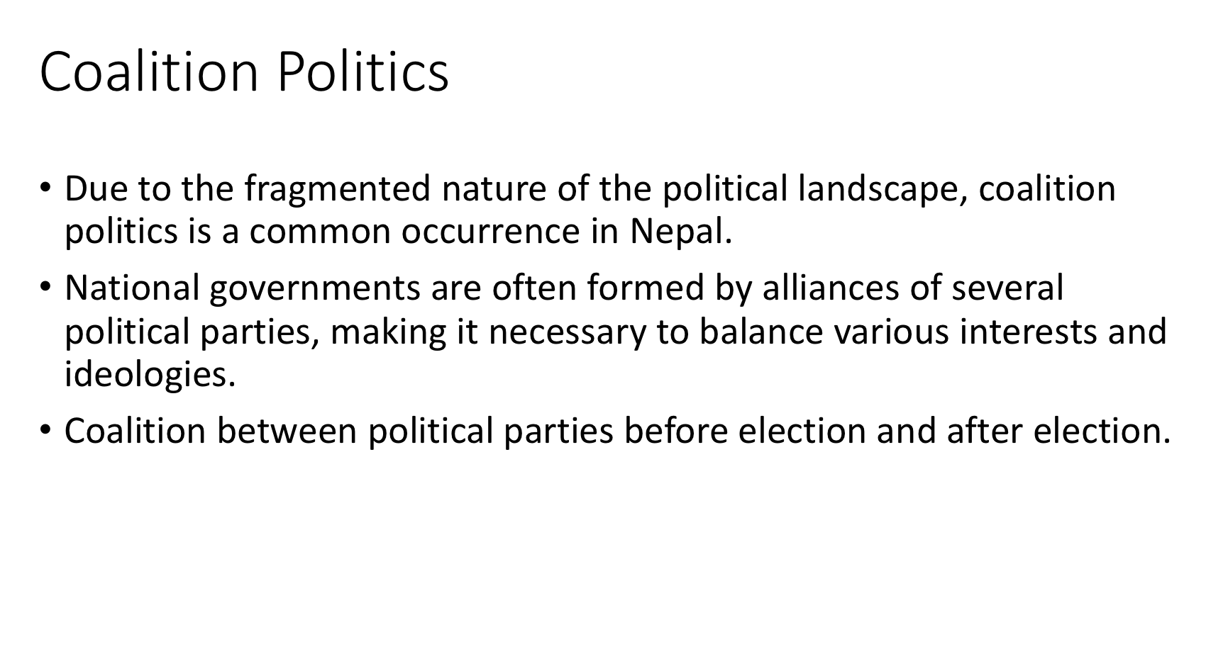

Slide 21
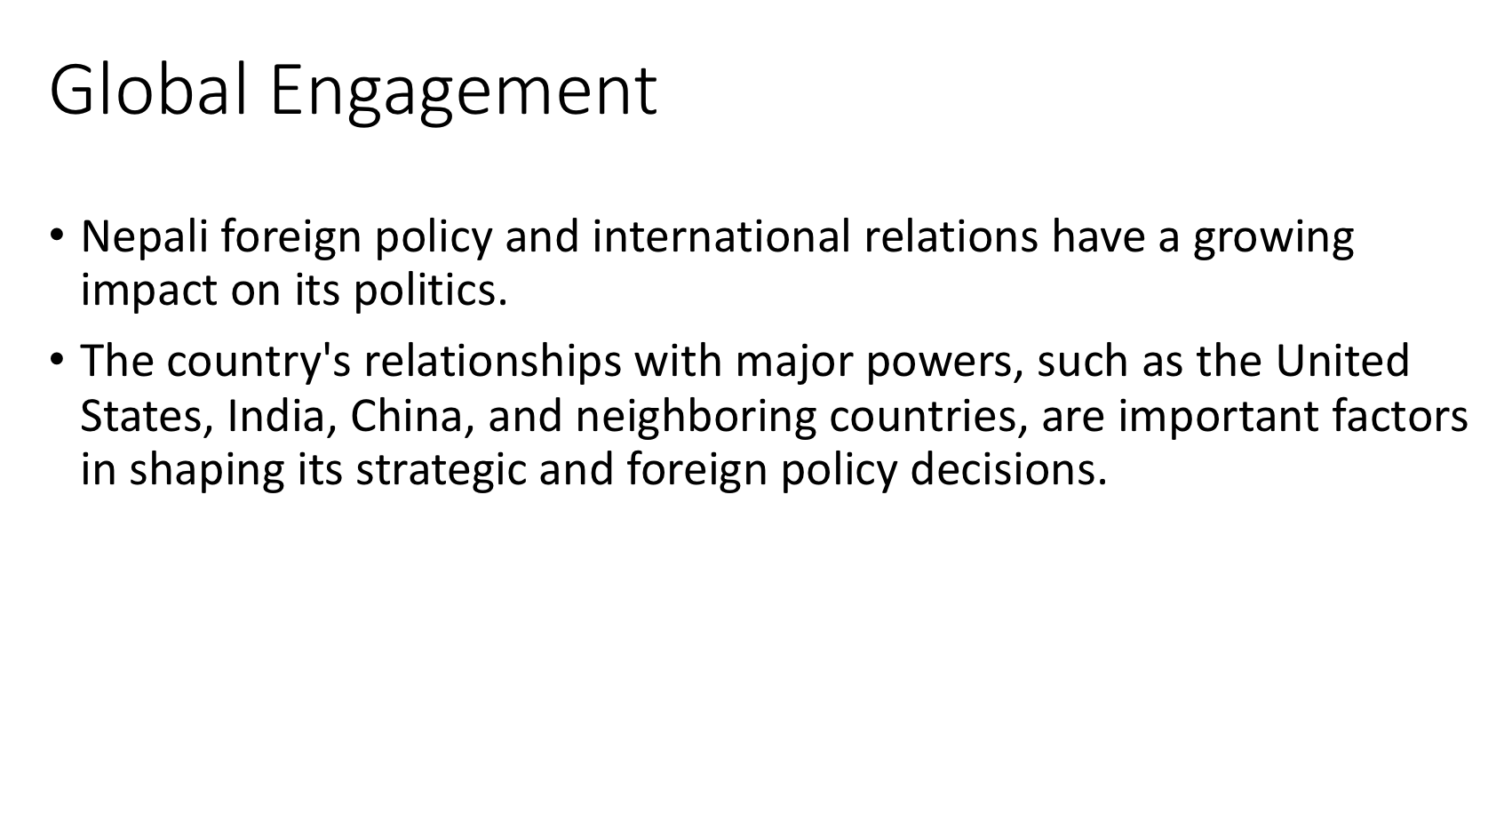

Slide 22
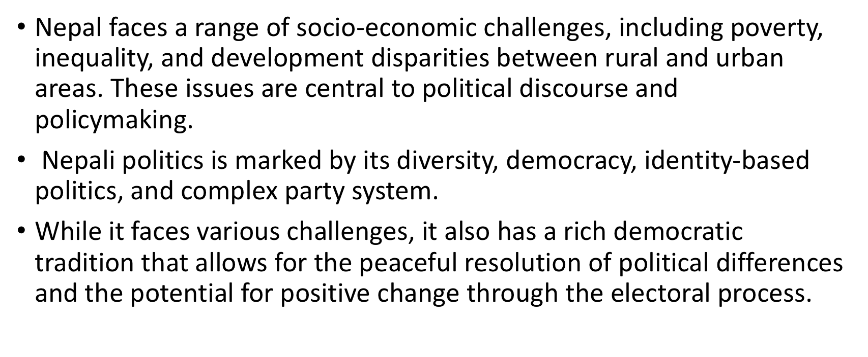

Slide 23
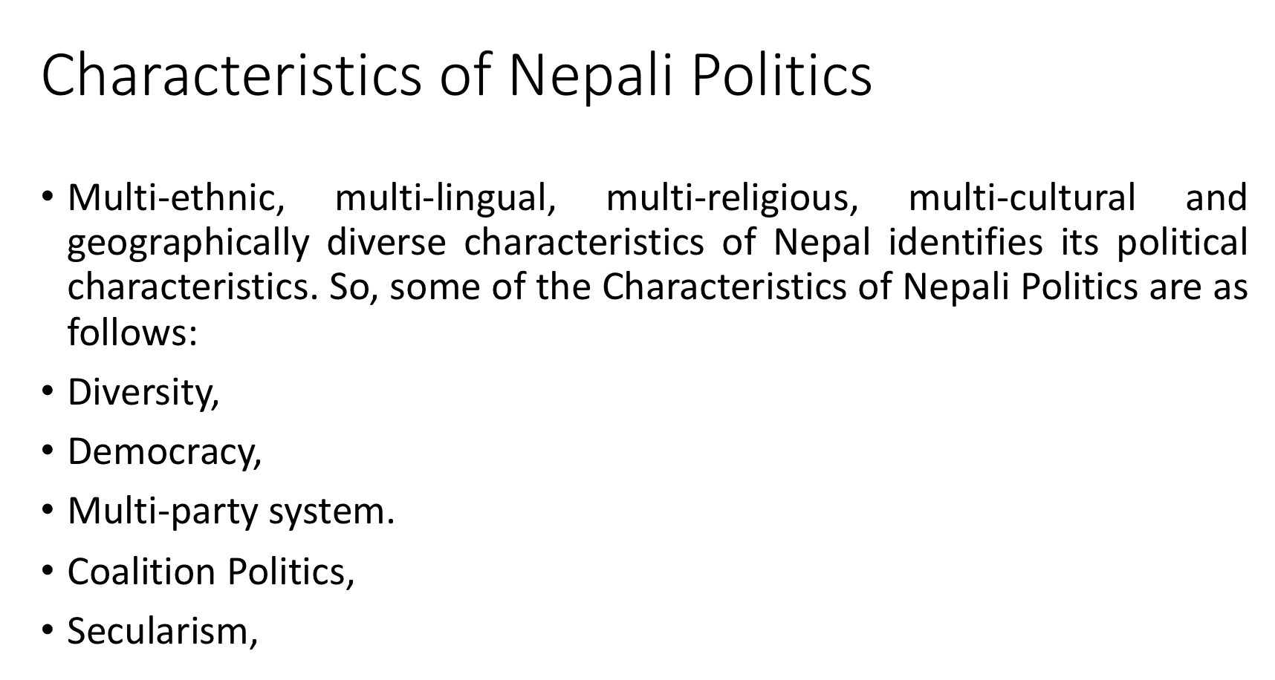

Slide 24
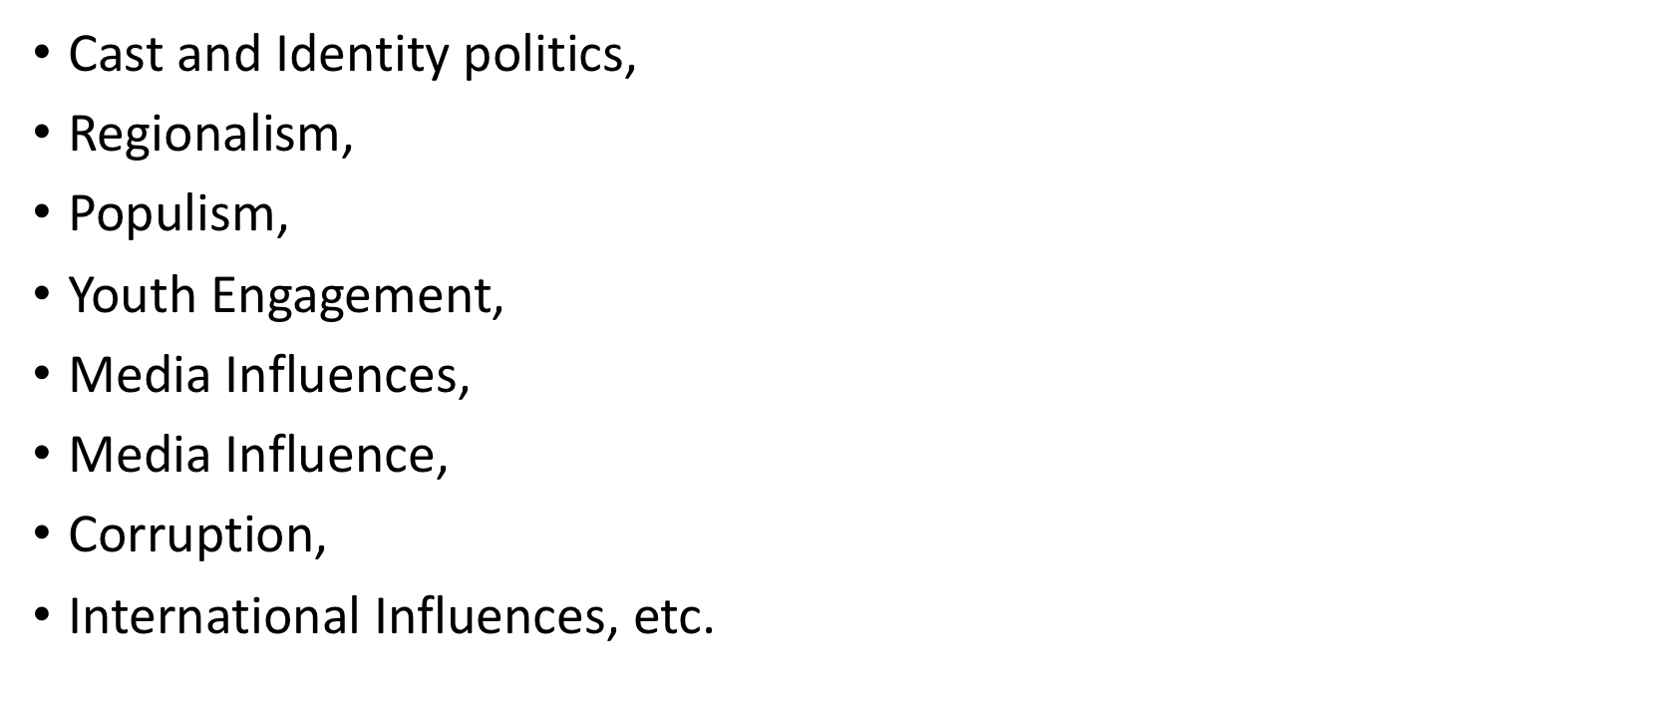

Slide 25
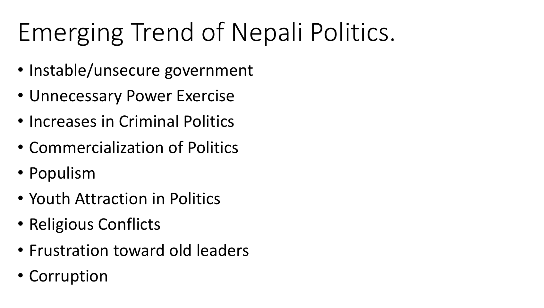

Slide 26


Slide 27
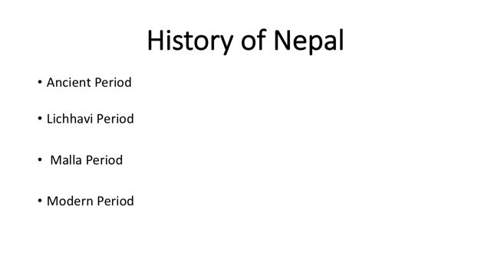

Slide 28
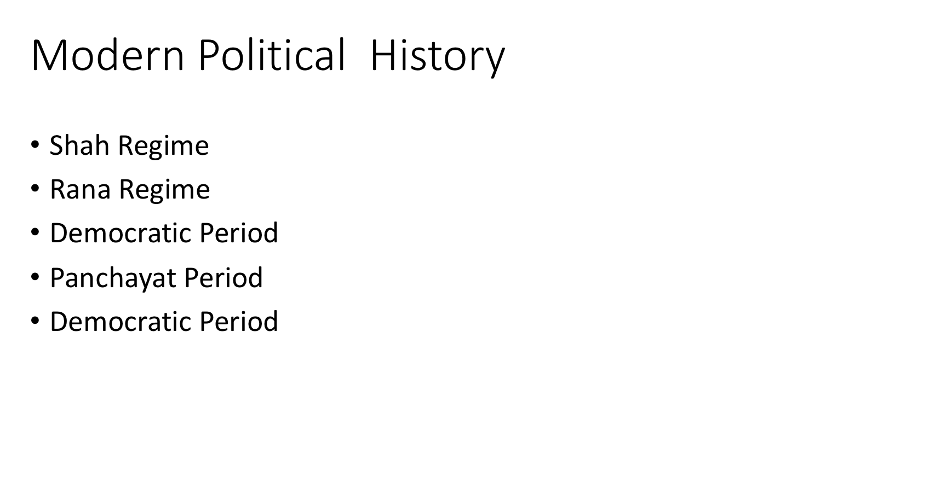

Slide 29
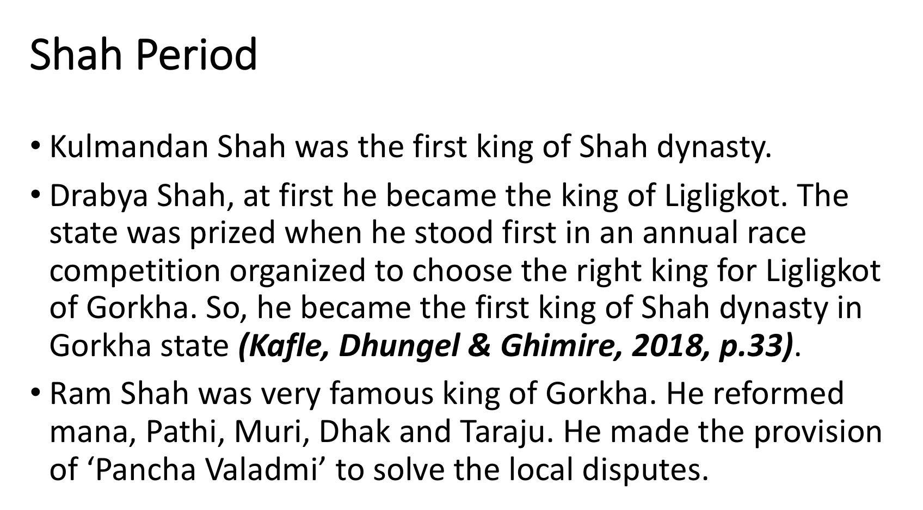

Slide 30
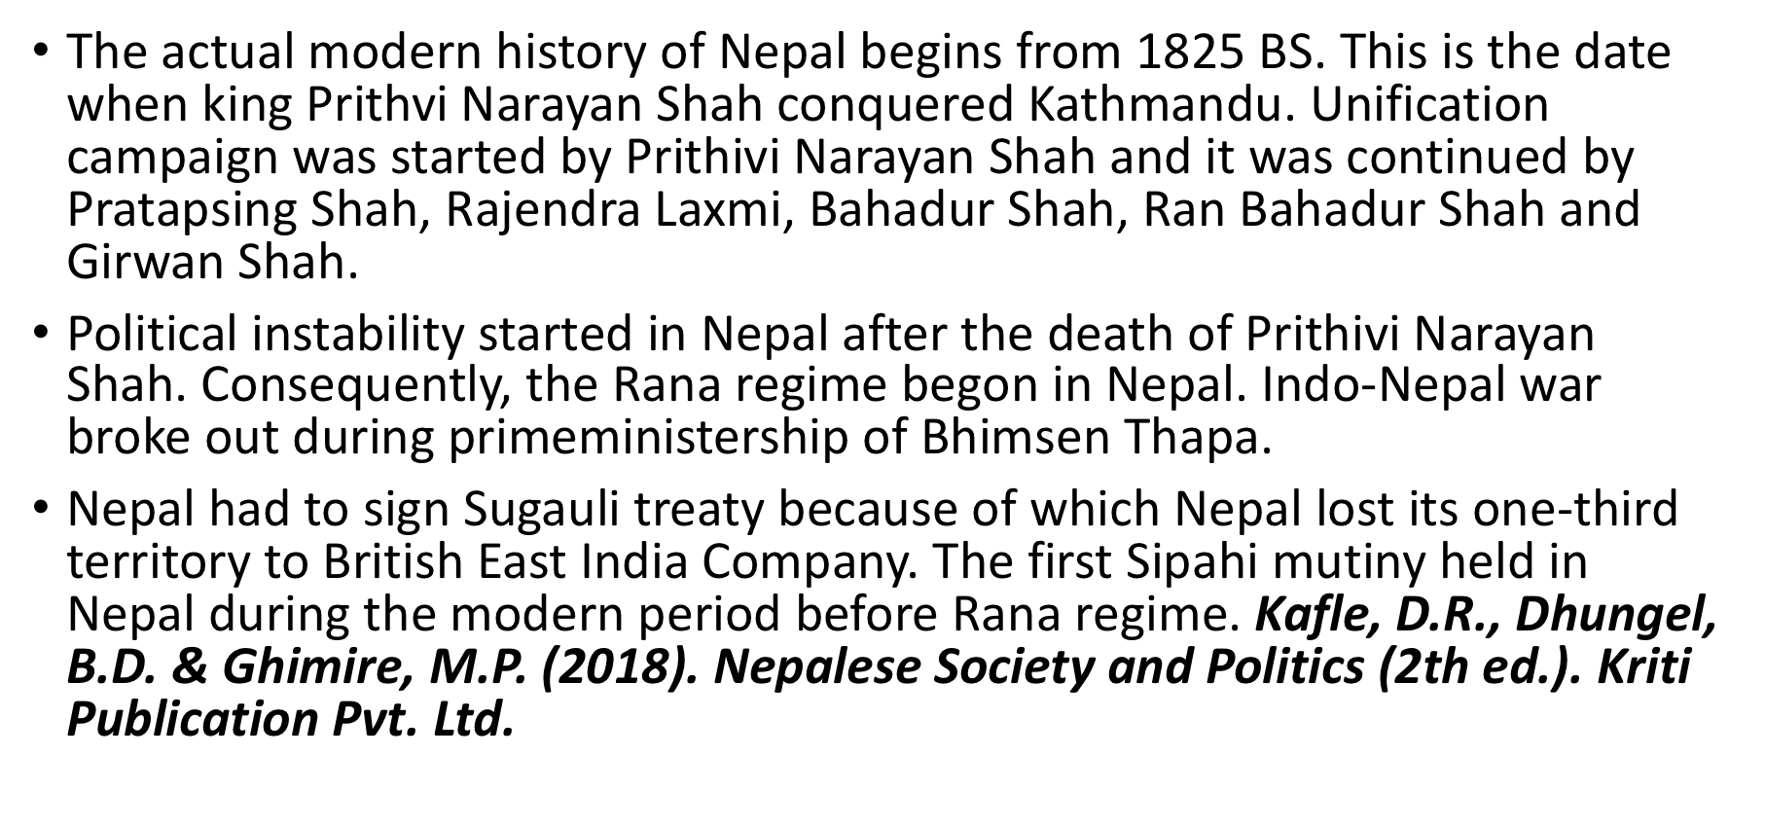

Slide 31
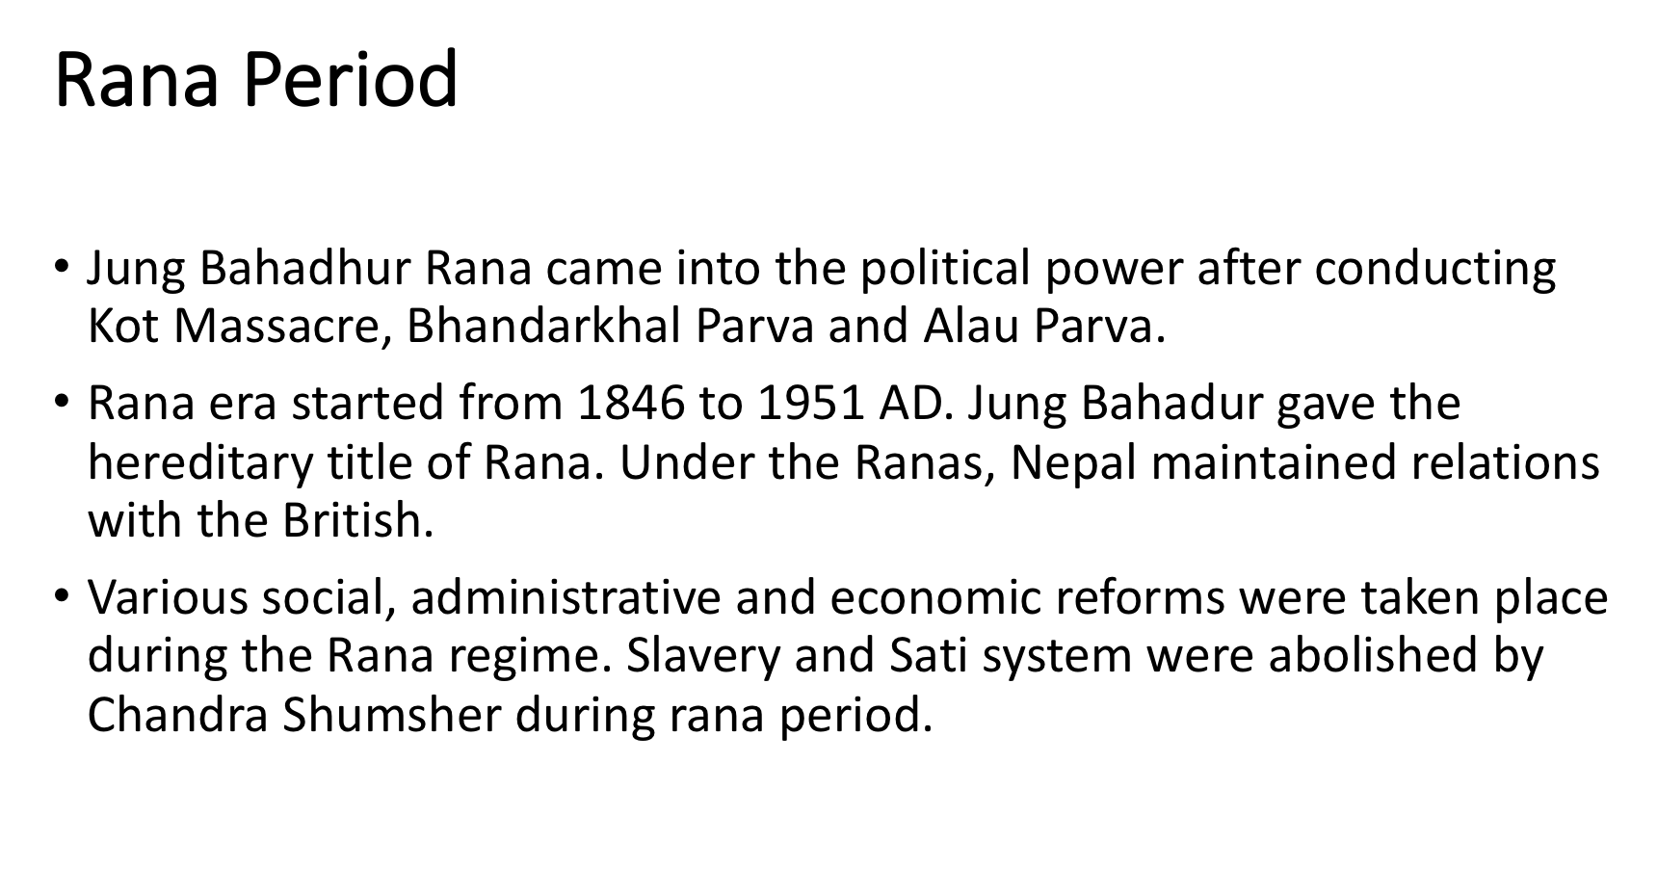

Slide 32
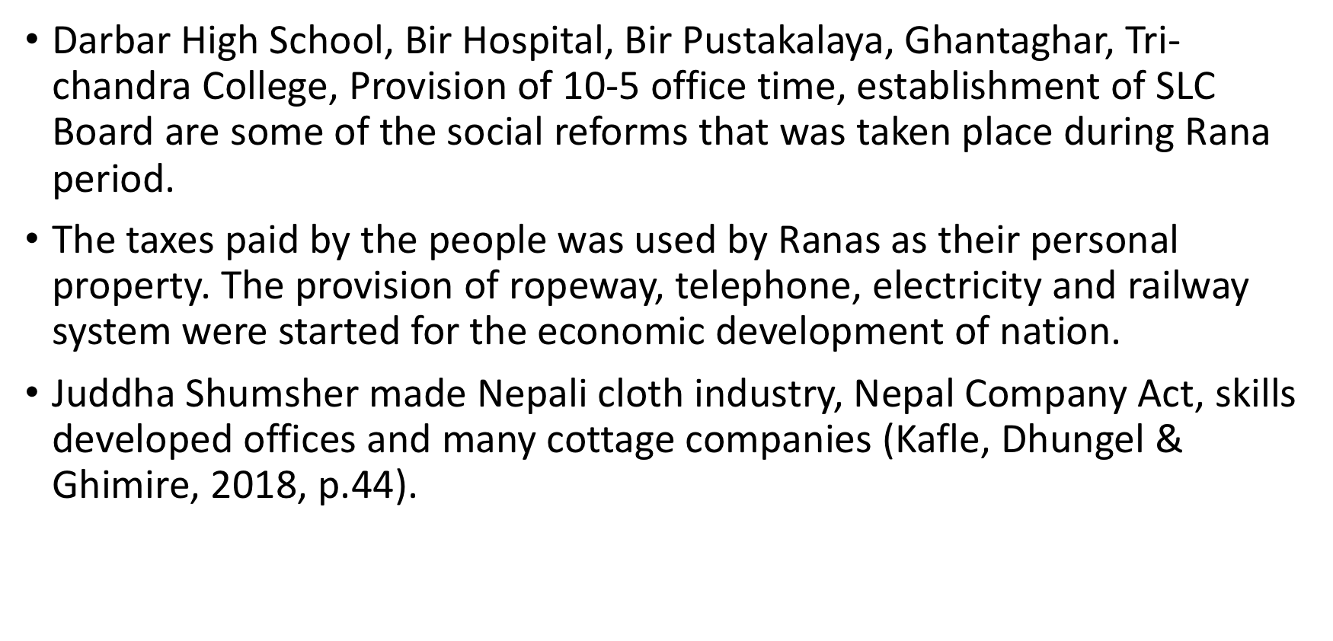

Slide 33
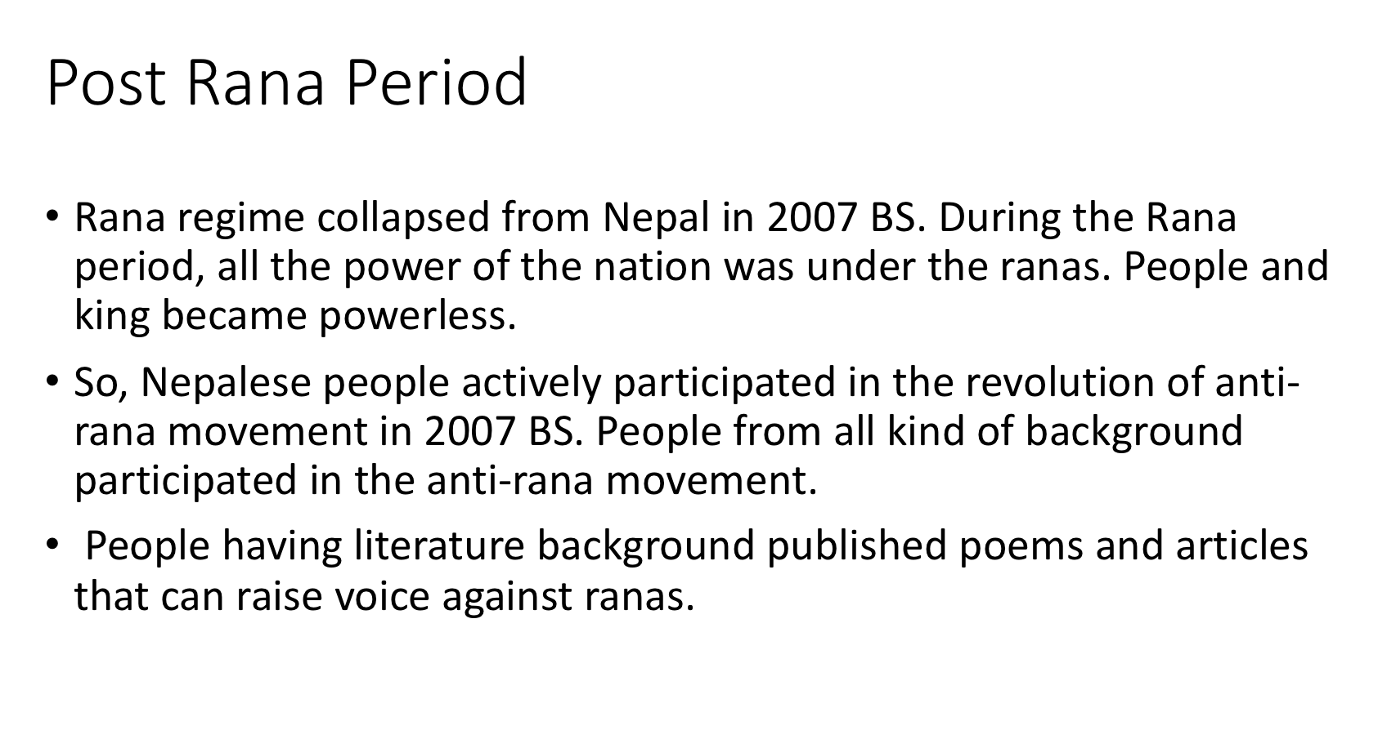

Slide 34
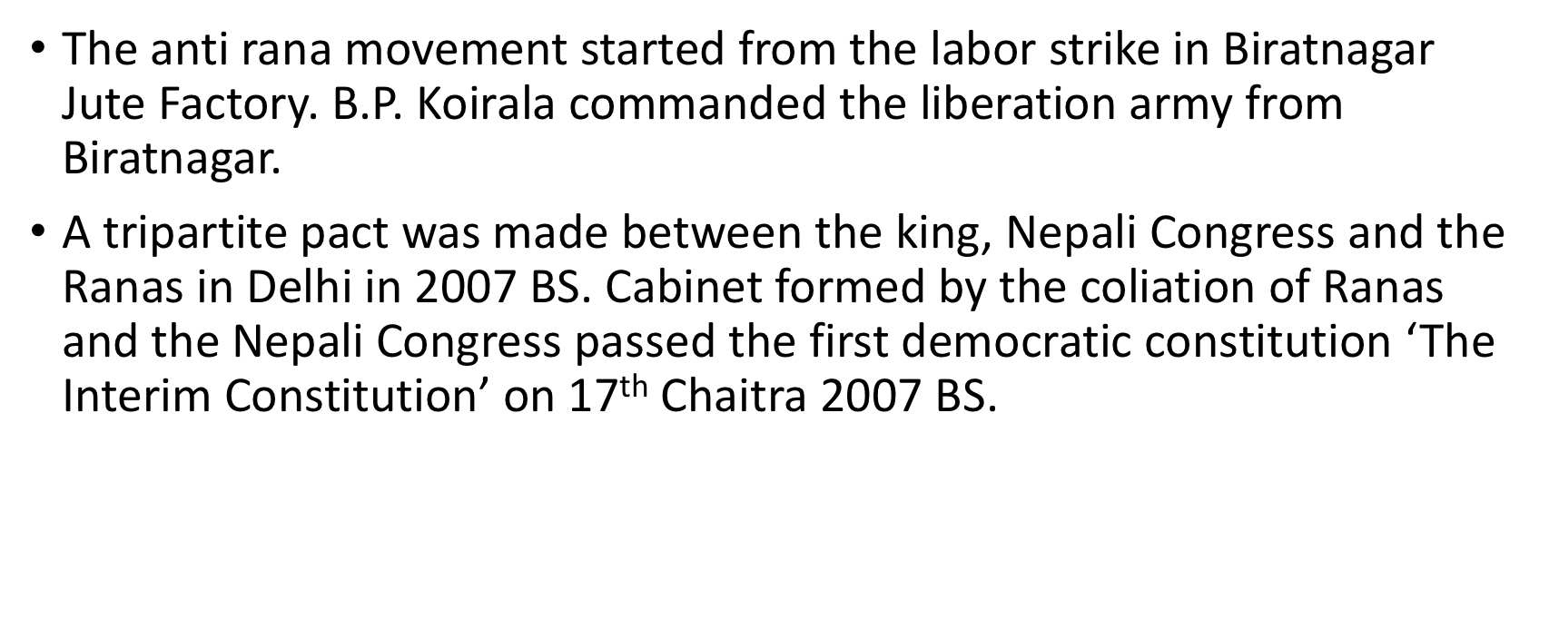

Slide 35
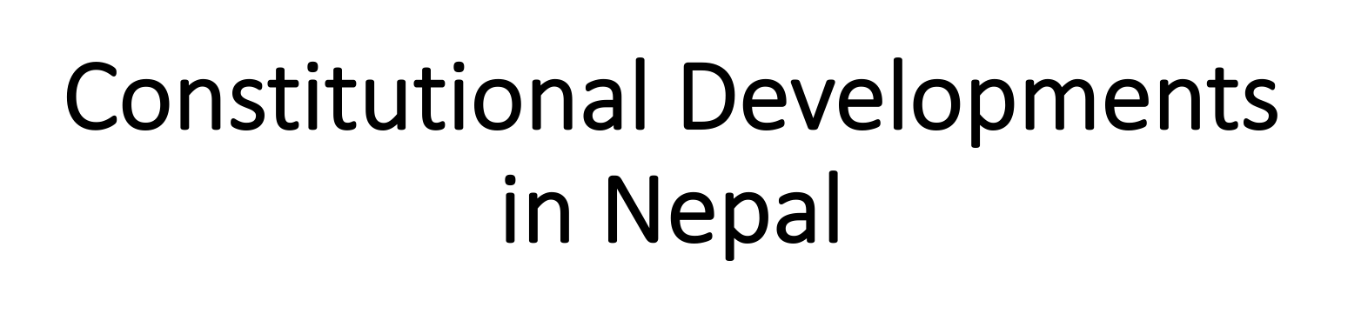

Slide 36
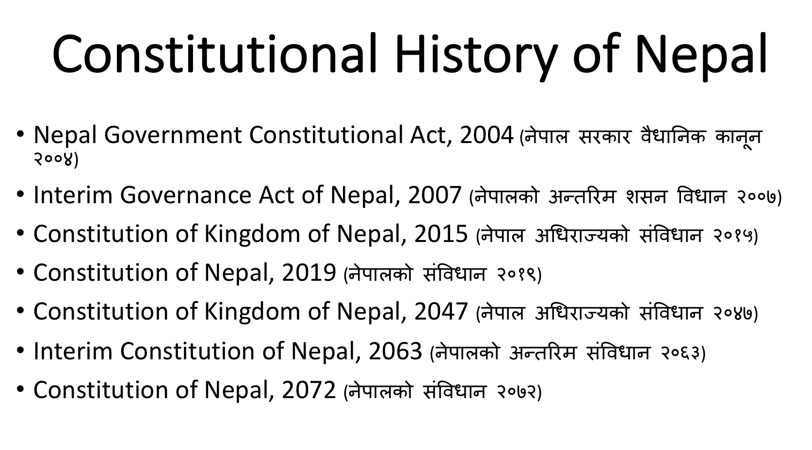

Slide 37
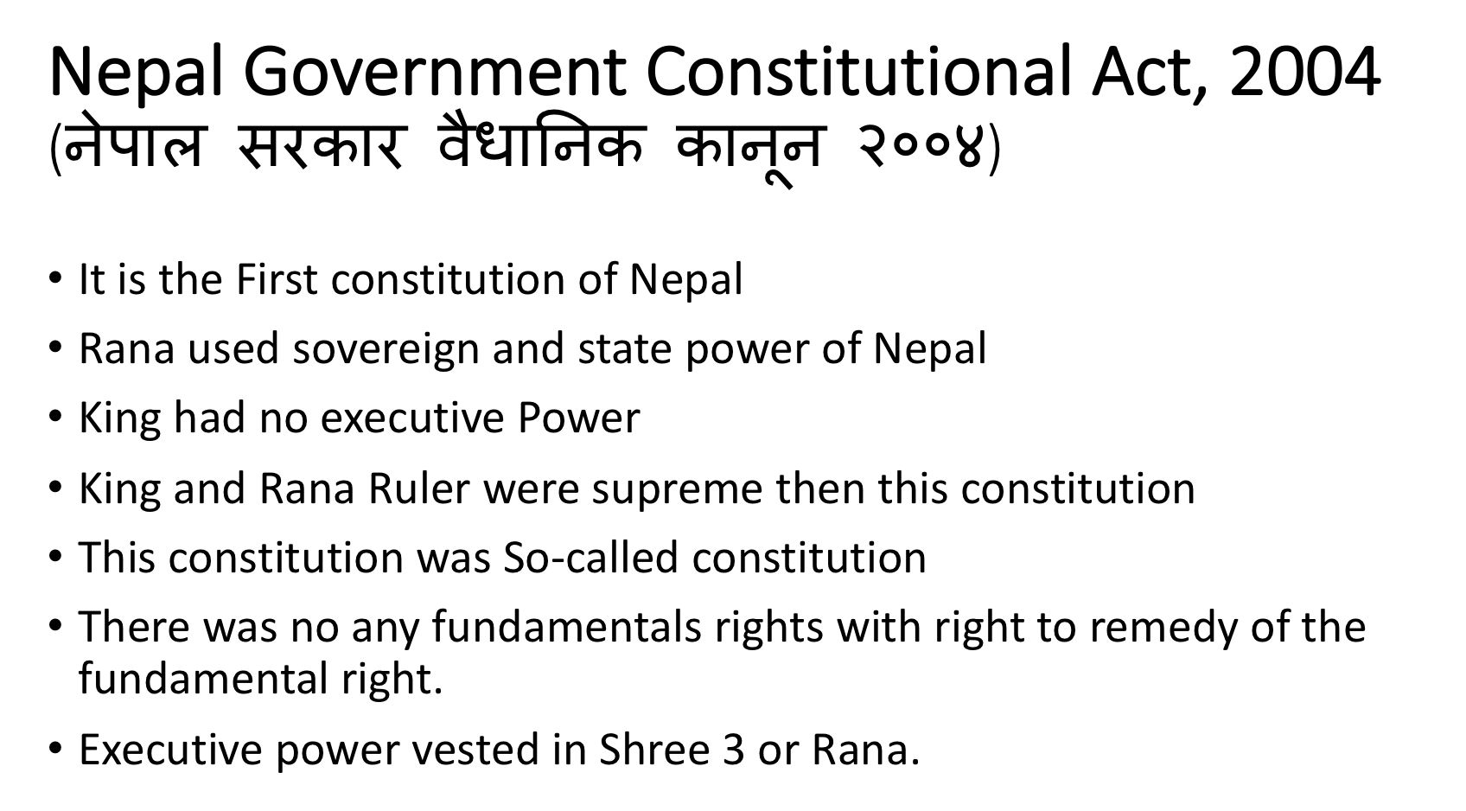

Slide 38
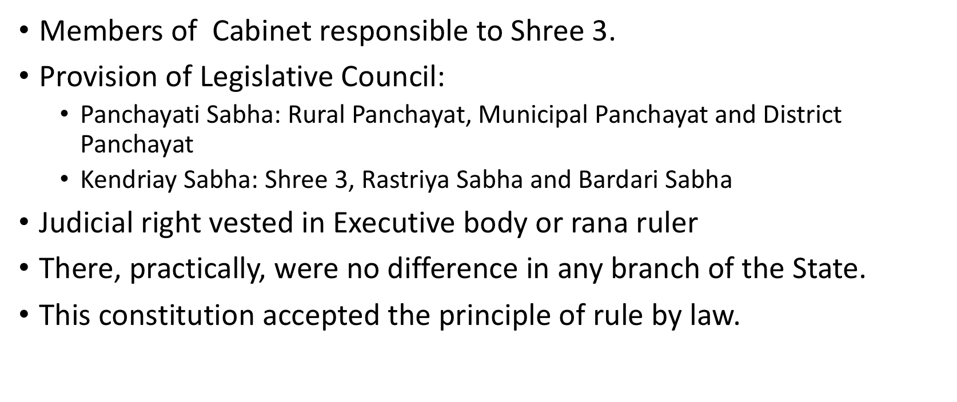

Slide 39
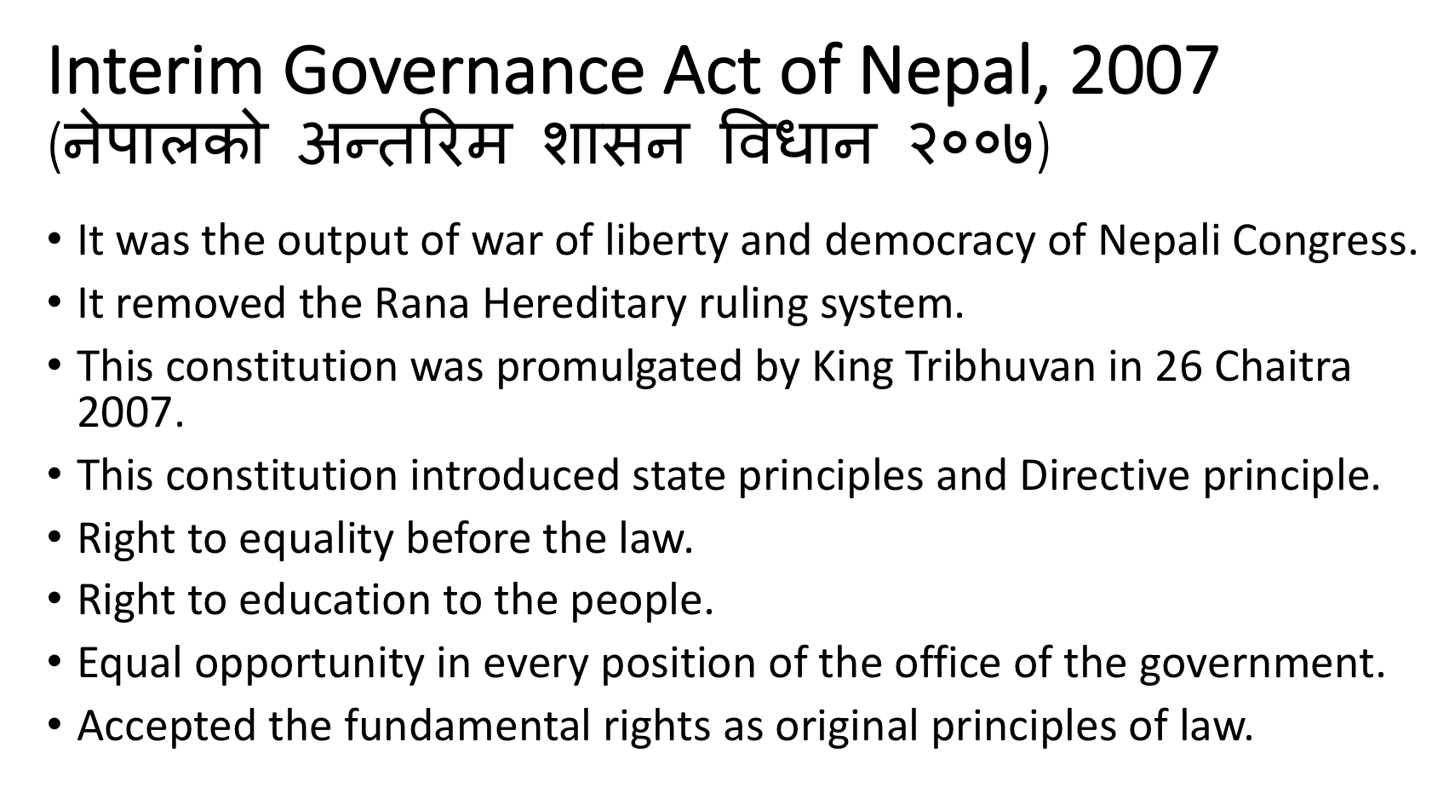

Slide 40
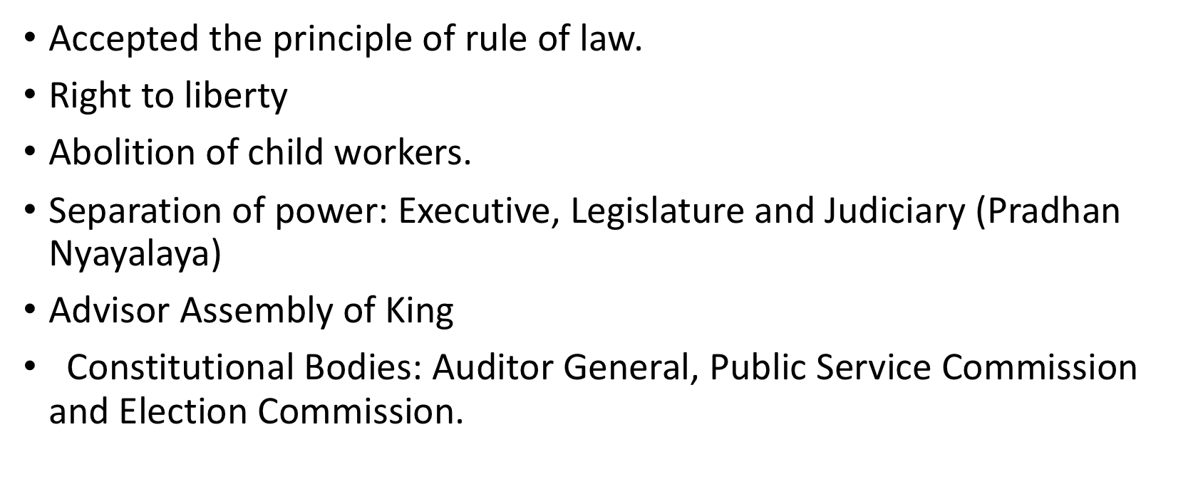

Slide 41
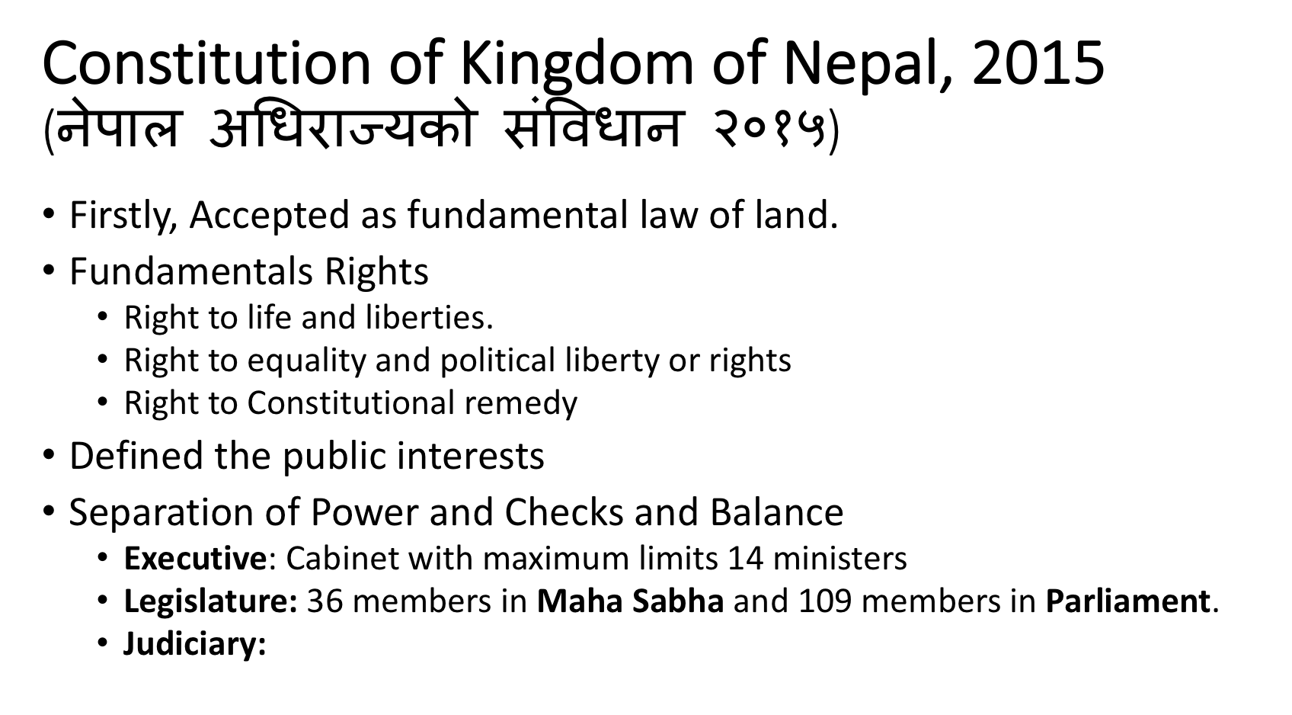

Slide 42
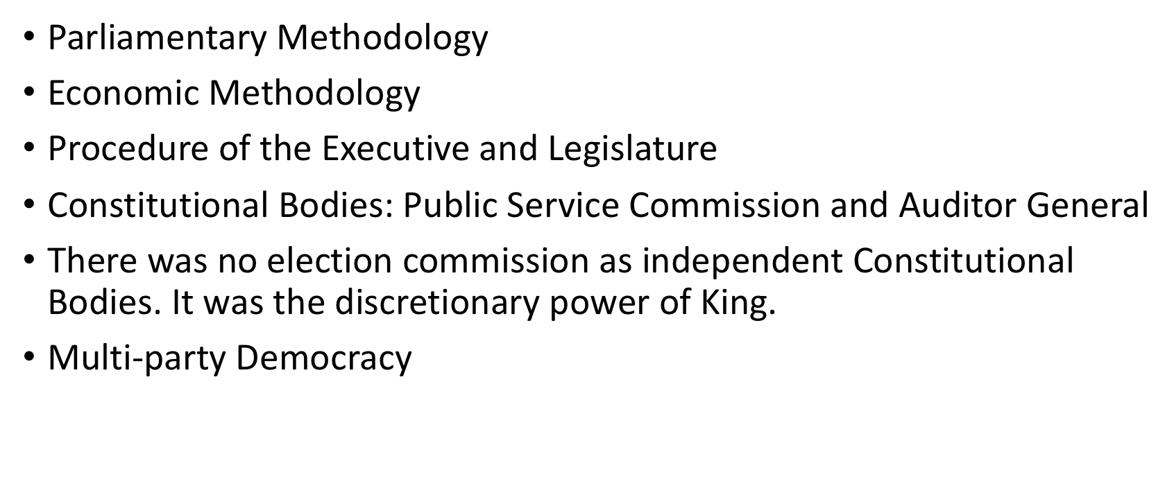

Slide 43
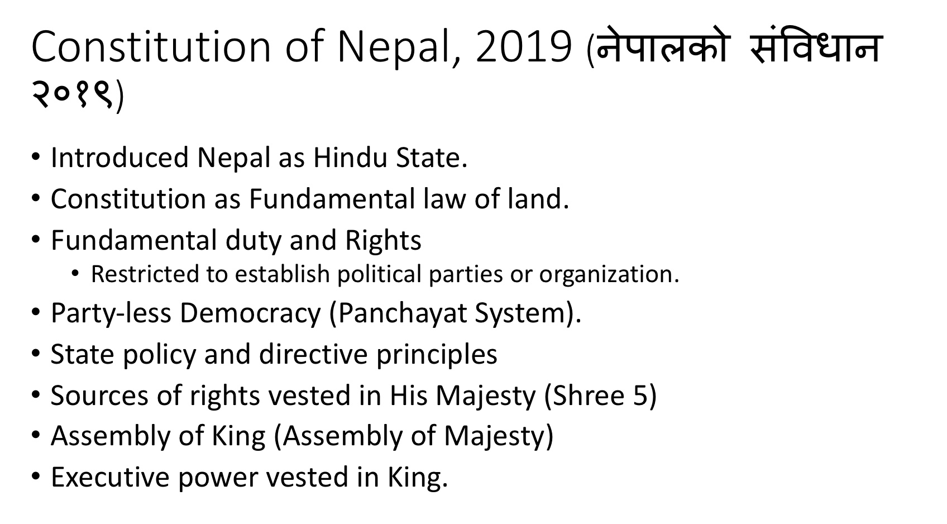

Slide 44
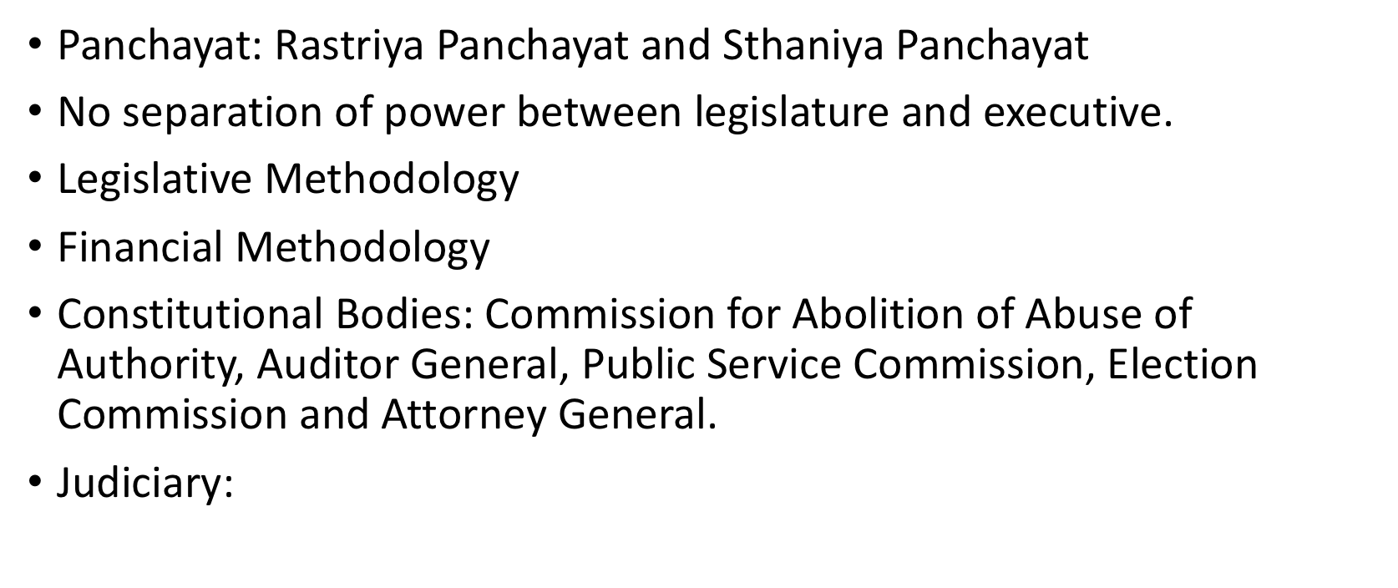

Slide 45
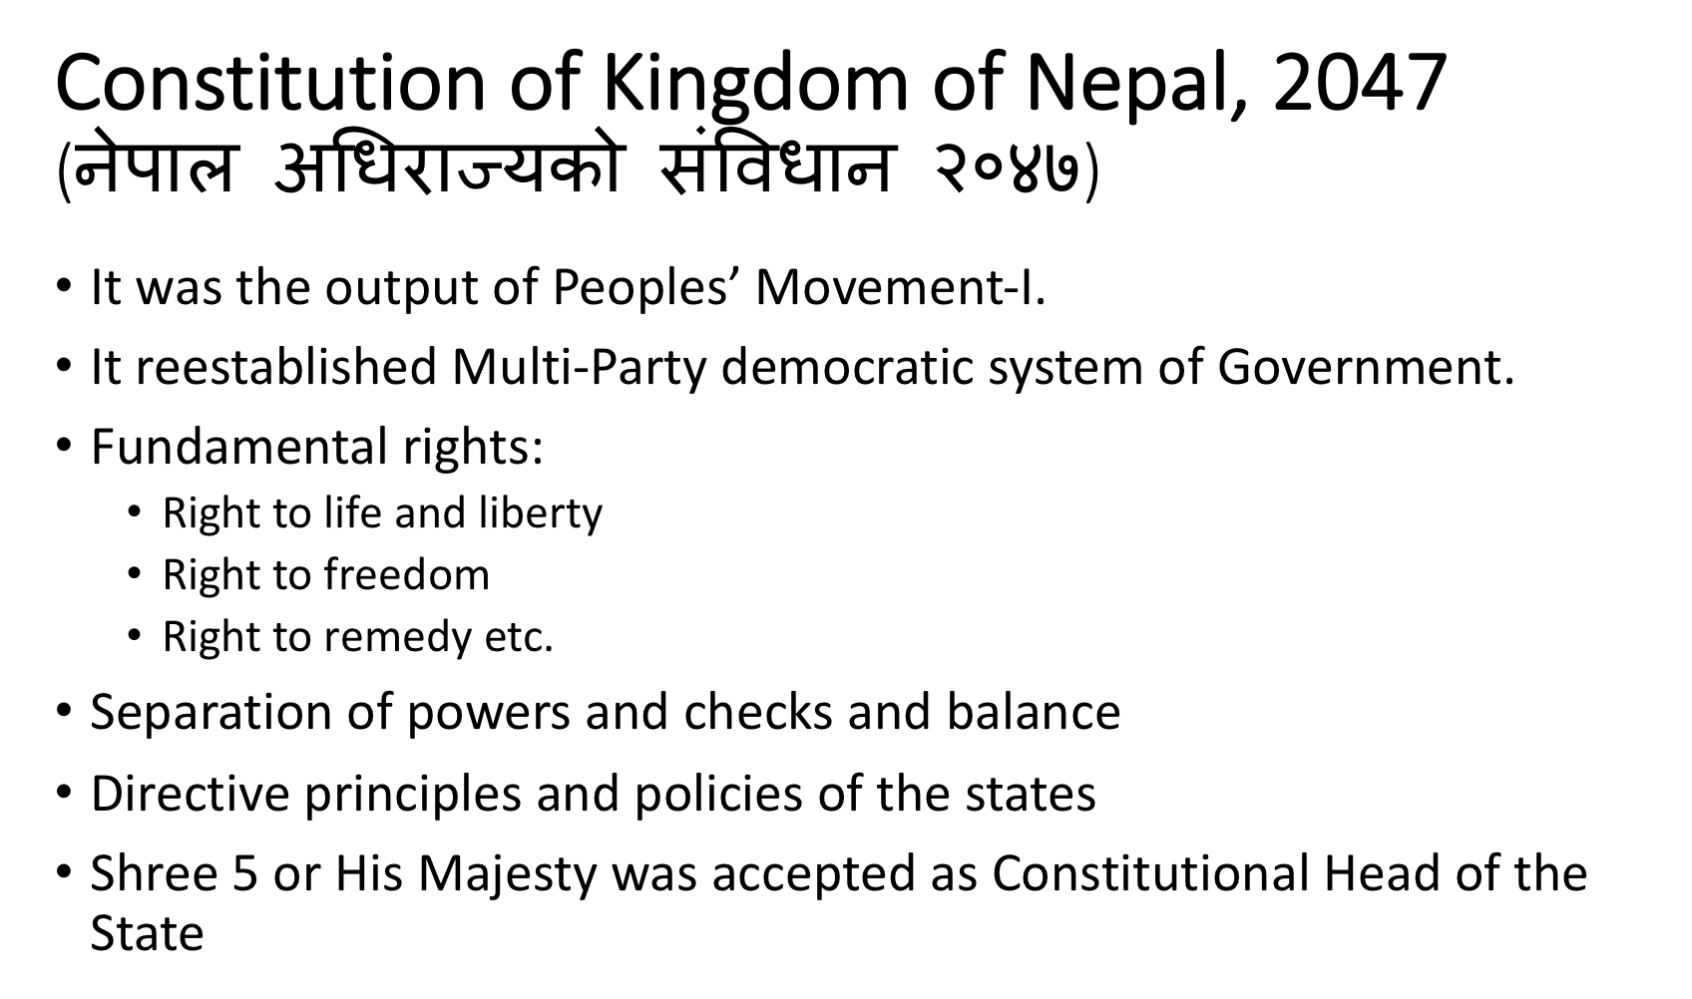

Slide 46
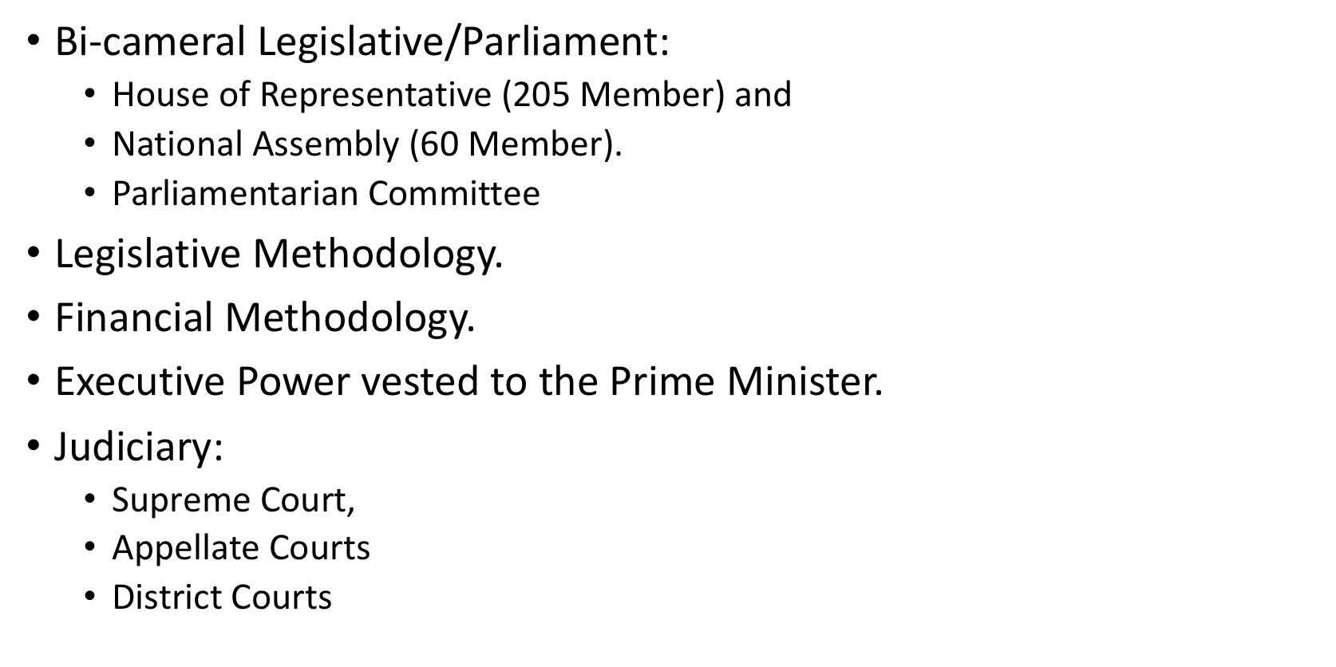

Slide 47
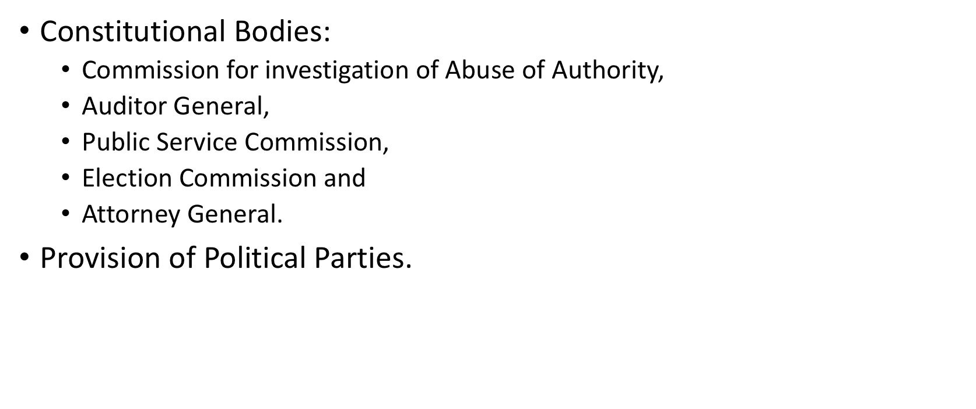

Slide 48
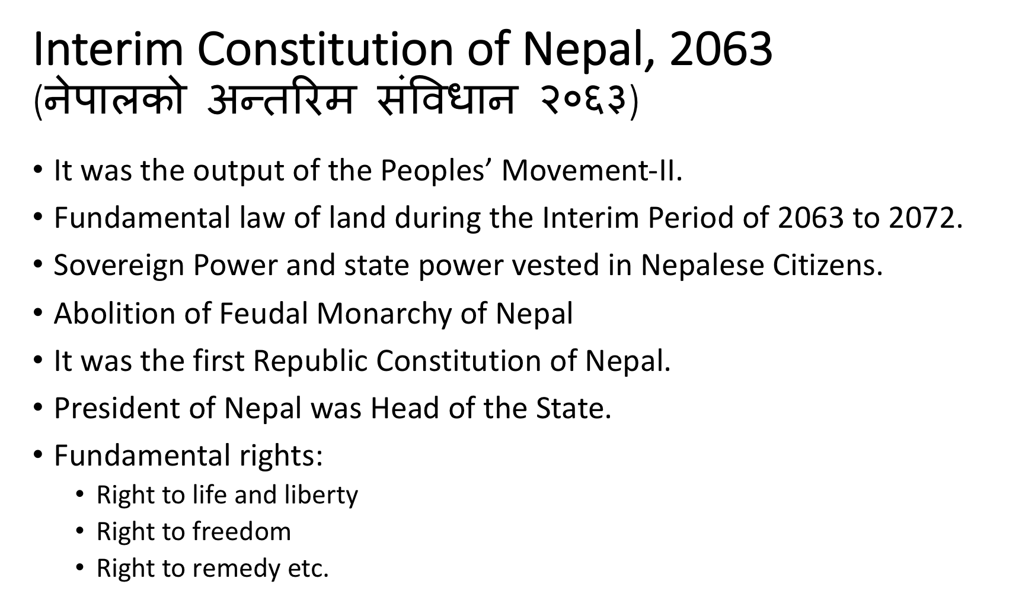

Slide 49
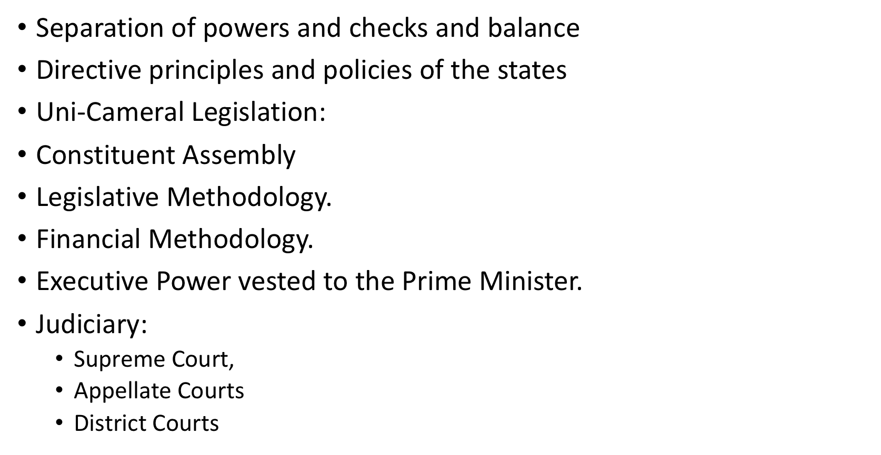

Slide 50
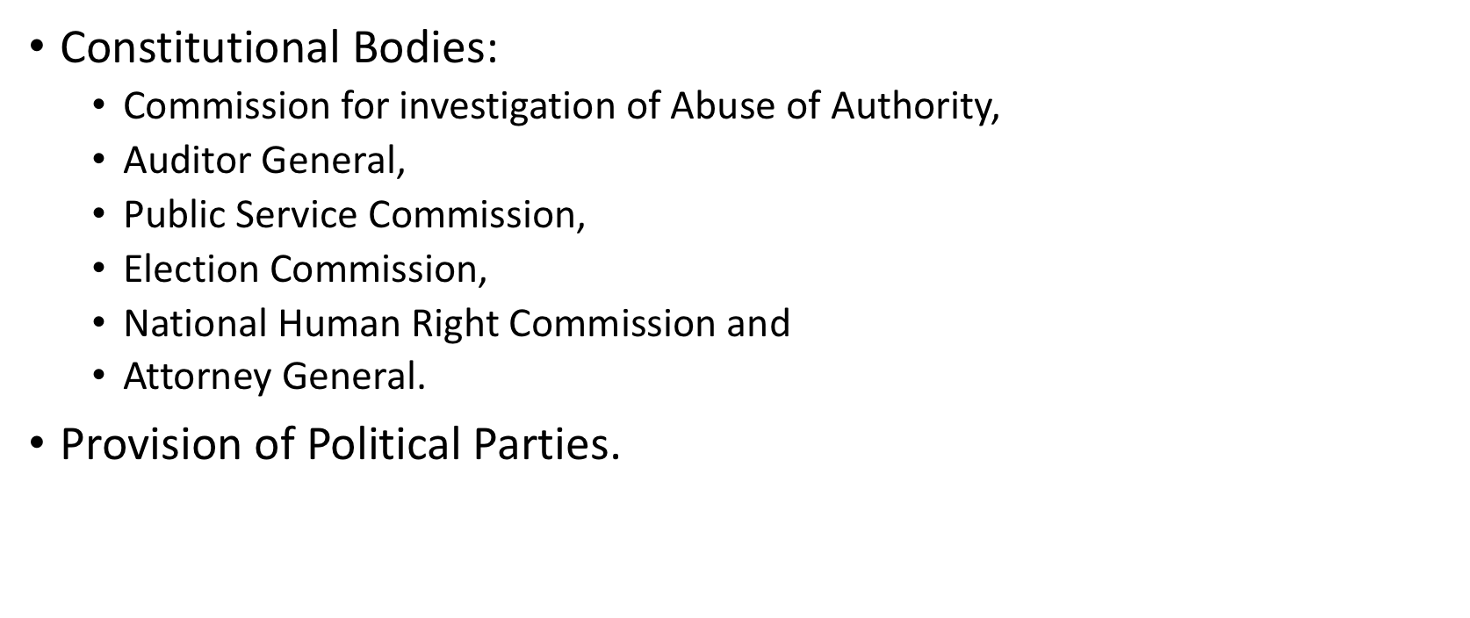

Slide 51
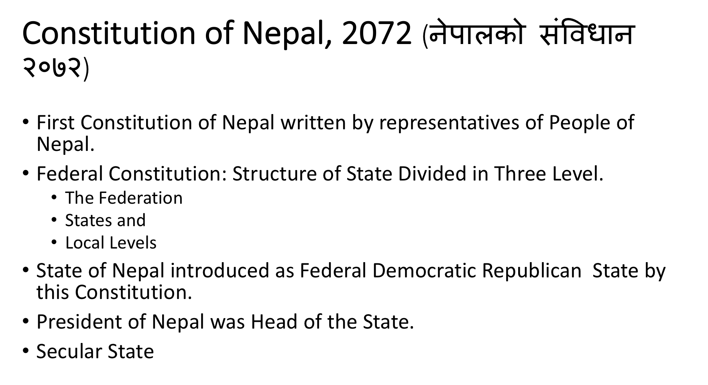

Slide 52
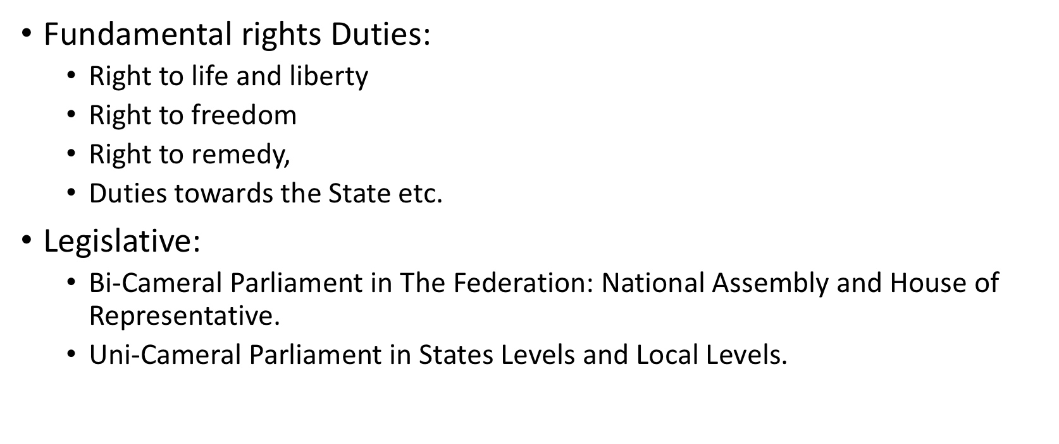

Slide 53
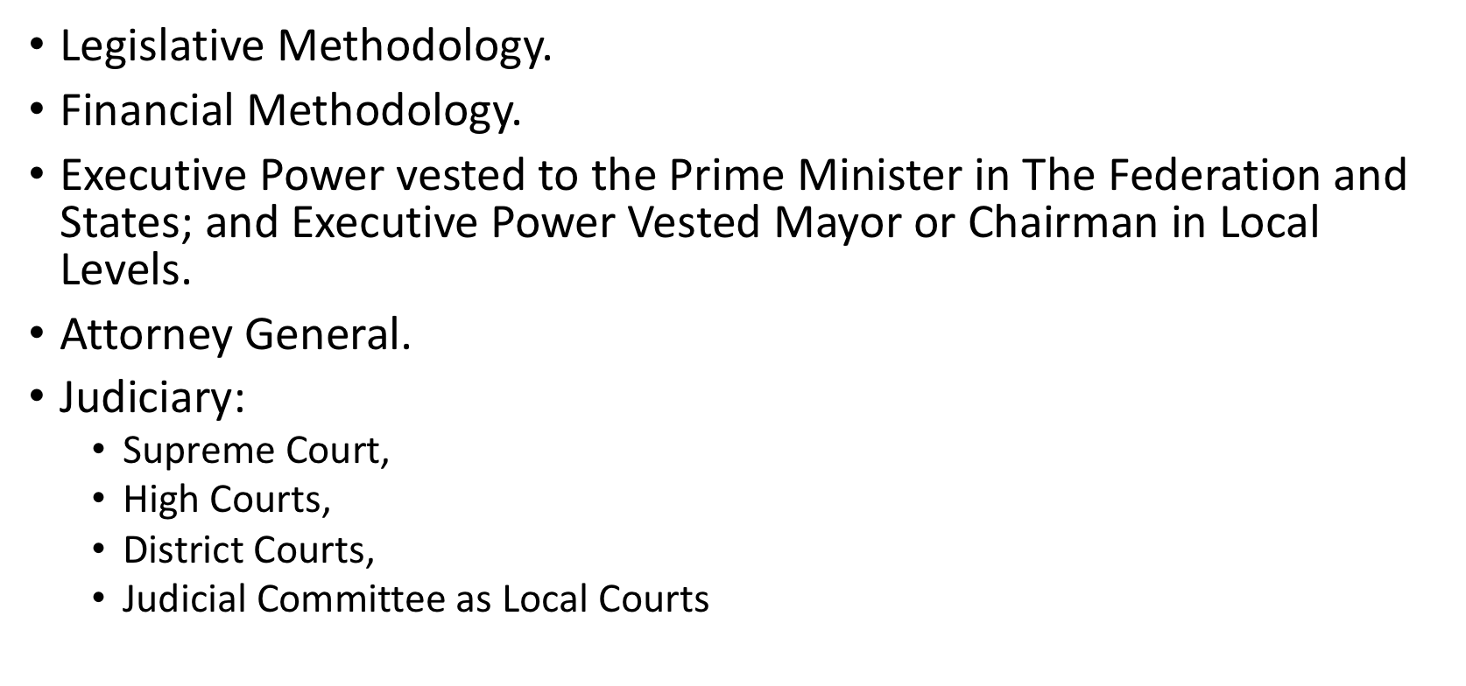

Slide 54
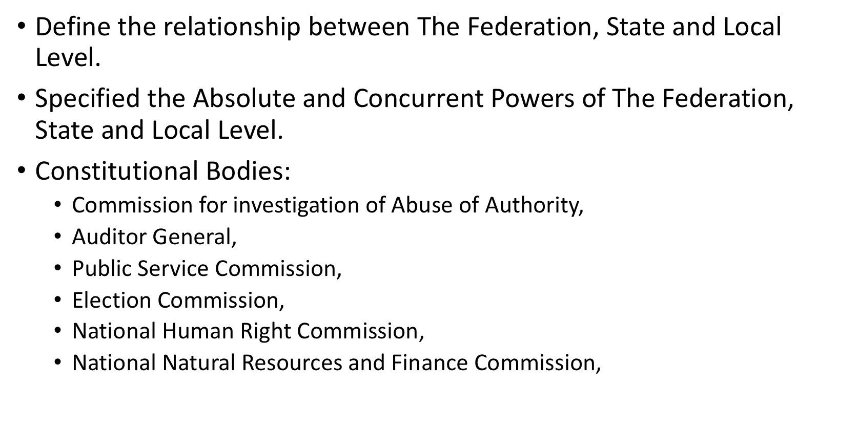

Slide 55
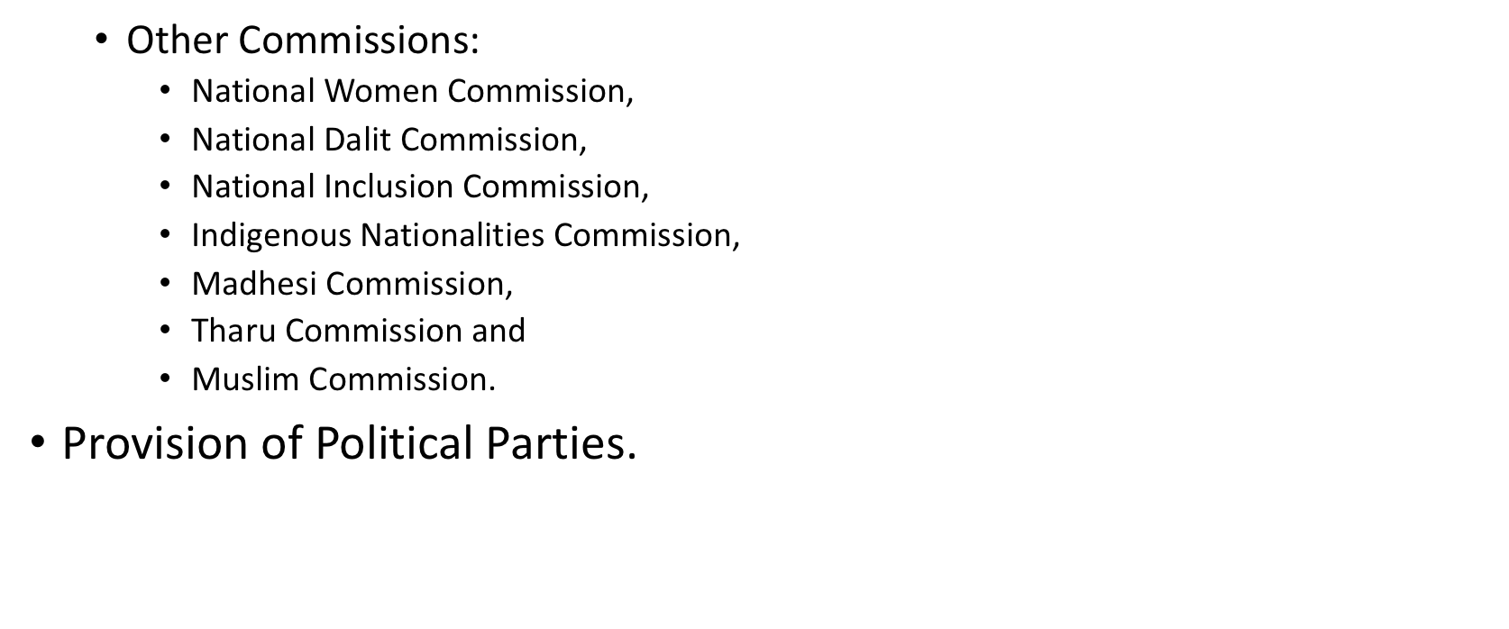

Slide 56
Political Transformation in Nepal
Political transformation in Nepal refers to the major changes in the country’s political system, governance structures and power relations over time. Nepal has experienced a remarkable transition from an absolute monarchy to a federal democratic republic. This transformation has been shaped by popular movements, constitutional reforms, armed conflict, and the restructuring of the state.

Slide 57
Early Political Structure: Monarchy and Rana Rule (Before 1951)
Before the mid-twentieth century, Nepal was governed under a monarchical system. From 1846 to 1951, the country was dominated by the hereditary Rana oligarchy established after the Kot Massacre. The Rana prime ministers held real power while the monarchy remained symbolic.
Key characteristics of this period:
Centralized authoritarian rule
Lack of democratic institutions
Isolation from international politics
Limited political participation of citizens
Political transformation began when democratic movements emerged against the Rana regime, supported by political parties and exiled leaders.

Slide 58
Panchayat Era (1960–1990)
In 1960, King Mahendra dissolved parliament and banned political parties, introducing the Panchayat system. This system claimed to be a partyless democracy but was essentially a centralized monarchical system.
Features of the Panchayat system:
Partyless political structure
Strong royal authority
Limited political freedoms
Centralized governance
While the system aimed at stability and development, it suppressed political rights and opposition voices.

Slide 59
People’s Movement of 1990 and Constitutional Monarchy
A major turning point came with the People’s Movement of 1990 (Jana Andolan I). Political parties and civil society mobilized against the Panchayat system.
Results of the 1990 movement:
Restoration of multiparty democracy
Promulgation of the Constitution of Nepal 1990
Establishment of constitutional monarchy
Expansion of civil liberties and political rights
However, governance challenges, corruption, and inequality persisted.

Slide 60
Maoist Insurgency (1996–2006)
Nepal faced another major transformation during the Nepalese Civil War launched by the Communist Party of Nepal (Maoist) in 1996. The insurgency aimed to abolish monarchy and establish a republican state.
Impacts:
Over 17,000 deaths
Weakening of state institutions
Rise of republican and federal ideas
Increased demand for social inclusion and restructuring of the state
The conflict significantly reshaped Nepal’s political landscape.

Slide 61
People’s Movement of 2006 and the End of Monarchy
The People’s Movement of 2006 (Jana Andolan II) was a historic uprising against the direct rule of King Gyanendra.
Major outcomes:
Restoration of parliament
Comprehensive Peace Agreement between the government and Maoists
Beginning of the peace process and democratic transition
This movement ultimately led to the abolition of the monarchy.

Slide 62
Establishment of the Federal Democratic Republic (2008)
In 2008, the Constituent Assembly of Nepal declared Nepal a Federal Democratic Republic, formally ending the 240-year monarchy.
Key changes:
Abolition of the monarchy
Establishment of republican governance
Commitment to federalism, inclusion and secularism
This marked one of the most significant transformations in Nepal’s political history.

Slide 63
New Constitution and Federal System (2015)
Another milestone was the promulgation of the Constitution of Nepal 2015. The constitution institutionalized major structural changes.
Key features:
Federal system with three levels of government (federal, provincial, local)
Secular state
Inclusion and proportional representation
Fundamental rights for citizens
Nepal was reorganized into seven provinces, reshaping the state structure.

Slide 64
Contemporary Political Transformation
Today, Nepal’s political transformation continues through democratic consolidation and governance reforms.
Key issues:
Stability of coalition governments
Implementation of federalism
Economic development and governance reforms
Role of political parties and civil society
Managing identity and inclusion politics
Despite challenges, Nepal has moved significantly toward democratic governance.

Slide 65
Period / Year Major Event Key Political Change
1846 Kot Massacre Beginning of the ‘Rana oligarchy’ under Jung Bahadur Rana, hereditary prime ministers ruled Nepal while the monarchy became symbolic.
1846–1951 Rana Regime Authoritarian rule, isolation from global politics, no democratic institutions.
1951 1951 Nepalese Revolution End of Rana rule; restoration of monarchy under King Tribhuvan and introduction of democratic politics.
1959 First Democratic Election Parliamentary democracy established; Bishweshwar Prasad Koirala became the first elected Prime Minister.
1960 Royal Coup King Mahendra dissolved parliament and banned political parties.
1962–1990 Panchayat System Partyless political system under the monarchy with centralized authority.
1990 People’s Movement of 1990 (Jana Andolan I) End of Panchayat system, restoration of multiparty democracy and constitutional monarchy.
1990 Constitution of Nepal 1990 Institutionalization of parliamentary democracy and civil liberties.
1996–2006 Nepalese Civil War Armed insurgency led by Communist Party of Nepal (Maoist) demanding republicanism and social restructuring.
2001 Nepalese royal massacre Death of King Birendra and royal family, King Gyanendra became king, intensifying political crisis.
2006 People’s Movement of 2006 (Jana Andolan II) Restoration of parliament; monarchy’s power drastically reduced. 2006 Comprehensive Peace Accord End of the civil war, Maoists entered mainstream politics.
2008 Republic Declaration Constituent Assembly of Nepal abolished the monarchy and declared Nepal a Federal Democratic Republic
2015 Constitution of Nepal 2015 Establishment of a federal democratic system with seven provinces
2017 First Federal Elections Implementation of federal governance at federal, provincial and local levels.
2020–Present Democratic Consolidation Ongoing debates on federalism, political stability, coalition governments and governance reforms.

Slide 66
Unit II : Nepali Politics in Transition
2.1 Socio-political Movements for Democracy
2.2 Decade Long Maoist Insurgency and Peace Process
2.3 Election for Constituent Assembly
2.4 New Constitution Making Process

Slide 67
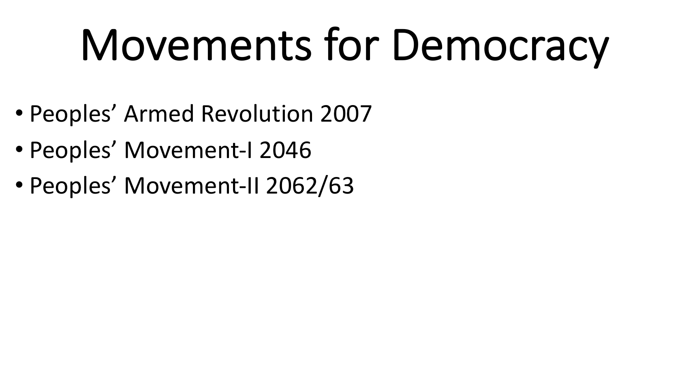

Slide 68


Slide 69


Slide 70


Slide 71


Slide 72


Slide 73


Slide 74


Slide 75


Slide 76


Slide 77


Slide 78


Slide 79


Slide 80


Slide 81


Slide 82


Slide 83


Slide 84


Slide 85
Contemporary Democratic Movements
Even after the establishment of democracy, socio-political activism continues in Nepal. Civil society organizations, youth groups, and social movements advocate for:
Good governance and accountability
Anti-corruption reforms
Inclusive representation
Protection of democratic rights
These movements strengthen democratic institutions and encourage political accountability.

Slide 86
Decade Long Maoist Insurgency and Peace Process

Slide 87



Slide 88



Slide 89



Slide 90



Slide 91



Slide 92



Slide 93



Slide 94



Slide 95



Slide 96



Slide 97



Slide 98



Slide 99
The Decade-Long Maoist Insurgency and Peace Process in Nepal (1996–2006) is one of the most significant political transformations in modern Nepal. It fundamentally reshaped the state structure, led to the end of monarchy and established a federal democratic republic.
Background of the Maoist Insurgency
The Maoist insurgency emerged from political, social and economic inequalities that existed after the restoration of multiparty democracy in 1990. Despite democratic reforms, many marginalized communities such as rural peasants, ethnic minorities, Dalits and poor farmers felt excluded from political power and development.
The insurgency was led by the Pushpa Kamal Dahal (Prachanda) and ideologically guided by Baburam Bhattarai, under the political organization Communist Party of Nepal (Maoist).
The Maoists aimed to overthrow the monarchy and establish a people’s republic based on Maoist ideology.
Beginning of the Maoist Insurgency (1996)
The insurgency officially started on 13 February 1996, when the Maoists launched armed attacks against police posts in several districts such as Rolpa, Rukum and Sindhuli.
Before launching the rebellion, the Maoists submitted a 40-point demand to the government led by Sher Bahadur Deuba. These demands focused on:
Ending monarchy and feudalism
Addressing poverty and unemployment
Ensuring ethnic and regional autonomy
Reducing foreign influence in Nepal’s economy and politics
When the government ignored these demands, the Maoists declared the “People’s War.”

Slide 100
Major Phases of the Insurgency (1996–2006)
a. Early Phase (1996–2001)
Maoists expanded influence in remote rural districts, especially in western Nepal.
Government response was mainly police operations rather than military involvement.
The insurgency gradually spread across the country.
A major turning point occurred during the Nepalese Royal Massacre, when King Birendra and many royal family members were killed. After this, Gyanendra of Nepal became king.
b. Escalation Phase (2001–2005)
After the massacre, violence intensified.
The government declared a state of emergency.
The Nepal Army was mobilized against the Maoists.
Thousands of people were killed in clashes between government forces and Maoist fighters.
During this period:
Maoists controlled large rural areas.
Political instability increased in Kathmandu.
King Gyanendra gradually expanded royal authority.
In 2005, King Gyanendra dissolved the government and assumed direct rule, claiming that political parties had failed to control the insurgency.
c. Final Phase (2005–2006)
The royal takeover united the Maoists and mainstream political parties against the monarchy.
In November 2005, the Maoists and seven major political parties signed the Twelve Point Agreement in New Delhi.
This agreement committed both sides to:
End autocratic monarchy
Restore democracy
Hold elections for a constituent assembly
Cooperate in a joint movement against the king

Slide 101
The People’s Movement (2006)
The agreement led to the nationwide People's Movement of 2006 (Jana Andolan II).
Millions of people participated in protests across Nepal demanding democracy and the end of monarchy.
Result:
King Gyanendra restored the parliament in April 2006.
Political parties formed a new government.
This movement marked the collapse of royal authoritarian rule.
Comprehensive Peace Agreement (2006)
The insurgency formally ended with the signing of the Comprehensive Peace Agreement on 21 November 2006 between the government and Maoists.
Major provisions of the agreement:
End of armed conflict and ceasefire.
Maoist fighters placed in cantonments under United Nations Mission in Nepal monitoring.
Integration and rehabilitation of Maoist combatants.
Commitment to human rights and democratic norms.
Election of a Constituent Assembly to draft a new constitution

Slide 102
Consequences of the Maoist Insurgency
Political Changes
Abolition of monarchy in 2008.
Nepal declared a Federal Democratic Republic.
Maoists entered mainstream politics.
Social Changes
Raised issues of inclusion, ethnicity and regional inequality.
Promoted discussions on federalism and social justice.
Economic Impact
Approximately 17,000 people were killed.
Infrastructure destruction and economic slowdown.
Rural areas suffered significant development setbacks.
Long-Term Political Transformation
The peace process resulted in major institutional changes:
2008 Nepalese Constituent Assembly Election
Drafting of a new constitution
Promulgation of the Constitution of Nepal 2015
These developments transformed Nepal from a Hindu monarchy into a secular federal democratic republic.
Challenges in the Peace Process
Despite success, several challenges remained:
Delays in constitution drafting
Disputes over federal boundaries
Integration of Maoist combatants
Transitional justice issues
Institutions like the Truth and Reconciliation Commission Nepal were created to address conflict era human rights violations.

Slide 103
The Maoists’ 40-Point Demand (1996)
Nationalism
1. All unequal treaties with India should be abolished.
2. The 1950 Indo-Nepal Treaty of Peace and Friendship should be cancelled or revised.
3. Gurkha recruitment into foreign armies should be stopped.
4. Foreign capital and monopoly control over Nepal’s economy should be restricted.
5 Nepal’s natural resources should be used for national development.
6. Foreign cultural influence that harms Nepalese culture should be controlled.
7. Border disputes with India should be resolved.
8. Nepal’s independent foreign policy should be strengthened.
Democracy and Political Reform
9. A new constitution should be drafted through a constituent assembly.
10. Absolute power of the monarchy should be ended.
11. Nepal should be declared a secular state.
12. Political prisoners should be released.
13. Corruption among political leaders should be punished.
14. Local self-government should be strengthened.
15. The army and police should be democratized.
16. Reactionary laws restricting freedom should be abolished.
17. Freedom of speech, press, and organization should be guaranteed.
18. State repression against political activists should stop.
19. Fair and democratic elections should be ensured.
20. The judiciary should be independent and accessible.
21. Administrative reforms should eliminate corruption.
22. People's participation in governance should increase.
23. State institutions should be accountable to citizens.
24. Bureaucratic inefficiency should be reformed.

Slide 104
Economic and Livelihood Issues
25. Land should be redistributed to landless peasants.
26. Feudal land ownership should be abolished.
27. Minimum wages for workers should be ensured.
28. Industrial development should be promoted.
29. Unemployment should be addressed through state policies.
30. Free education and health services should be provided.
31. Local resources should be used for rural development.
Social Justice and Cultural Rights
32. Caste discrimination should be abolished.
33. Equal rights should be ensured for women.
34. Patriarchal laws should be reformed.
35. Ethnic and indigenous communities should receive autonomy.
36. Regional inequality should be reduced.
37. Education should be available in mother languages.
38. Cultural rights of ethnic groups should be protected.
39. Dalits and marginalized communities should be uplifted.
40. Social justice and equality should be guaranteed in the state system.

Slide 105
Background of the Constituent Assembly Election
The Election for the Constituent Assembly (CA) in Nepal was a historic political event aimed at drafting a new constitution and restructuring the state after the end of the Maoist insurgency. It was a key outcome of the Comprehensive Peace Agreement signed between the Government of Nepal and the Communist Party of Nepal (Maoist).
The demand for a Constituent Assembly (CA) had been raised by various political forces in Nepal for decades, especially by the Maoists during the Nepalese Civil War.
After the success of the People's Movement of 2006 (Jana Andolan II), the restored parliament decided to hold elections for a Constituent Assembly to draft a new democratic constitution and restructure the state.
First Constituent Assembly Election (2008)
The first Constituent Assembly election was held on 10 April 2008. It was the first time in Nepal’s history that the people elected representatives specifically to draft a constitution.
Main Objectives
Draft a new constitution for Nepal
Decide the future of the monarchy
Restructure the state into a more inclusive and democratic system
Address issues of federalism, inclusion and representation
Electoral System
The election used a mixed electoral system:
First-Past-The-Post (FPTP) – direct election from constituencies
Proportional Representation (PR) – parties received seats according to national vote share
The Constituent Assembly had 601 members:
240 members elected through FPTP
335 members through proportional representation
26 members nominated by the government

Slide 106
Major Results of the 2008 Election
The biggest winner was the Communist Party of Nepal (Maoist), which emerged as the largest party in the assembly.
Major parties:
Communist Party of Nepal (Maoist) -229 seats
Nepali Congress - 115 seats
Communist Party of Nepal (Unified Marxist-Leninist) - 108 seats
Madhesi Janadhikar Forum- 54 seats
Others - 95 seats
Abolition of Monarchy (2008)
One of the most historic decisions of the Constituent Assembly was the abolition of the monarchy.
On 28 May 2008, the CA declared Nepal a Federal Democratic Republic, ending the 240-year-old Shah monarchy associated with Prithvi Narayan Shah and later kings including Gyanendra of Nepal.
Challenges of the First Constituent Assembly
Despite its historic role, the first Constituent assembly faced several challenges:
Disagreements over federalism and state boundaries
Power sharing disputes among political parties
Frequent changes of government
Delays in drafting the constitution
Due to these conflicts, the first Constituent Assembly failed to deliver a constitution and was dissolved in 2012.

Slide 107
Second Constituent Assembly Election (2013)
To overcome the political deadlock, Nepal held a second Constituent Assembly election on 19 November 2013.
Major parties in this election :
Nepali Congress - 196 seats
Communist Party of Nepal (Unified Marxist Leninist)- 175 seats
Unified Communist Party of Nepal (Maoist)- 80 seats
others - 150 seats
The Nepali Congress emerged as the largest party in this election.
Promulgation of the Constitution (2015)
The second Constituent Assembly successfully drafted and adopted the Constitution of Nepal 2015 on 20 September 2015.
The constitution established:
Federal democratic republic
Seven provincial governments
Secularism
Inclusive representation
Fundamental rights for citizens
Significance of the Constituent Assembly Election
The Constituent Assembly election is considered a turning point in Nepal’s political history because it
Ended monarchy and established a republic
Introduced federalism and inclusion
Integrated former Maoist rebels into democratic politics
Created a new constitution and political structure

Slide 108
New Constitution Making Process in Nepal
Background of Constitution Making
For many years, Nepal had constitutions granted by the monarchy rather than written by elected representatives. The demand for a constitution written by the people became stronger during the Nepalese Civil War.
The constitution-making process formally began after the People's Movement of 2006, which forced King Gyanendra of Nepal to restore democracy.
The process was institutionalized through the Comprehensive Peace Agreement between the government and the Maoists.
Interim Constitution (2007)
Before drafting the new constitution, Nepal adopted the Interim Constitution of Nepal 2007.
Interim constitution:
Ended the king’s political authority
Declared Nepal a secular state
Created the legal framework for the Constituent Assembly election
Included Maoists in mainstream politics
It served as a temporary constitution until a permanent one was written.

Slide 109
First Constituent Assembly (2008–2012)
The 2008 Nepalese Constituent Assembly Election was held on 10 April 2008 to elect representatives to draft a new constitution.
The Constituent Assembly had 601 members representing different political parties, ethnic groups, women, and marginalized communities.
Major Achievements
The first CA made some historic decisions:
Abolished the monarchy in 2008
Declared Nepal a Federal Democratic Republic
Began discussions on federalism, inclusion, and governance structure
However, it faced several political disagreements regarding:
Federal state boundaries
Form of government
Identity-based federalism
Due to these disputes, the first CA failed to produce a constitution and was dissolved in 2012.
Second Constituent Assembly (2013–2015)
After the failure of the first CA, Nepal held another election: the 2013 Nepalese Constituent Assembly Election.
Major parties involved in drafting the constitution included:
Nepali Congress
Communist Party of Nepal (Unified Marxist–Leninist)
Unified Communist Party of Nepal (Maoist)
This second Constituent Assembly restarted the constitution drafting process.
Drafting and Promulgation of the Constitution
The drafting process involved:
Public consultations
Parliamentary debates
Committee discussions
Political negotiations among parties
Finally, on 20 September 2015, the new constitution was promulgated as the Constitution of Nepal 2015.

Slide 110
Major Features of the New Constitution
The 2015 constitution introduced several fundamental changes:
1. Federal System- Nepal was divided into 7 provinces.
2. Republican System- The monarchy was permanently abolished.
3. Secular State- Nepal was declared a secular country.
4. Inclusive Democracy- Representation for women, Dalits, indigenous groups, Madhesis, and minorities.
5. Fundamental Rights- The constitution guarantees many rights such as
A. Right to equality
B. Right to education
C. Right to health
D. Freedom of speech
E. Right to employment and social security
Challenges in the Constitution-Making Process
Despite its success, the process faced several challenges:
Political disagreements among parties
Protests from Madhesi and ethnic groups
Debates over provincial boundaries
Delays in drafting
Some groups believed that the constitution did not adequately address their demands.
Significance of the Constitution Making Process
The constitution-making process is significant because it:
Completed Nepal’s peace process
Transformed Nepal from a monarchy into a federal republic
Institutionalized democratic governance
Promoted inclusive representation in politics

Slide 111
Unit III. Government System (Federal, Provinces and Local)
3.1 Legislature
3.2 Executive
3.3 Judiciary

Slide 112
Federal Government of Nepal
The Federal Government is the central authority responsible for national governance, sovereignty and overall policy direction.
Structure of Federal Government
Head of State
The ceremonial head of state is the President of Nepal.
Functions of the President:
Safeguards the constitution
Appoints the Prime Minister and other constitutional officials
Authenticates laws passed by parliament
Represents national unity
Although the president is the formal head of state, executive power is exercised by the government led by the Prime Minister.
Executive (Council of Ministers)
The executive power is exercised by the Prime Minister and Council of Ministers.
The Prime Minister is usually the leader of the majority party in the House of Representatives.
Functions of the Executive:
Implementation of national policies
Administration of the country
Conducting foreign relations
Managing defense and security
Preparing the national budget

Slide 113
Provincial Government
The constitution created seven provinces to decentralize power and bring governance closer to the people.
Provinces of Nepal( seven Province)
Koshi Province
Madhesh Province
Bagmati Province
Gandaki Province
Lumbini Province
Karnali Province
Sudurpashchim Province
Structure of Provincial Government
1. Provincial Chief
Appointed by the President
Acts as the ceremonial head of the province
Performs constitutional functions similar to the President at the provincial level.
2. Chief Minister
Head of the provincial government
Leader of the majority party in the Provincial Assembly
3. Provincial Council of Ministers
Assists the Chief Minister in governance
Responsible for provincial administration.
Responsibilities of Provincial Government
Provincial lawmaking
Provincial transportation and infrastructure
Provincial-level health services
Provincial education management
Agriculture and regional development

Slide 114
Local Government
The constitution gave strong authority to local governments to promote grassroots democracy.
Nepal has 753 local governments, including
6- Metropolitan
11 - Sub metropolitan
276 - Municipalities
460 - Rural Municipalities
Structure of Local Government
Local Executive
Mayor or Chairperson (head of local government)
Deputy Mayor or Vice Chairperson
Executive committee
Local Assembly
Legislative body at the local level
Consists of ward chairs and elected members.
Functions of Local Government
Local development planning
Basic education management
Primary healthcare services
Local road and infrastructure development
Registration of births, deaths, and marriages
Collection of local taxes
Local governments play a crucial role in grassroots development and participatory democracy.

Slide 115
Legislature of Nepal
The Legislature is responsible for making laws, overseeing government activities and approving the national budget.
Nepal has three levels of legislative bodies:
Federal Legislature
Provincial Legislature
Local Legislature
1. Federal Legislature (Federal Parliament)
Nepal has a bicameral parliament consisting of two houses.
House of Representatives (Pratinidhi Sabha)
Total Members: 275
Composition:
165 members elected through First-Past-The-Post system
110 members elected through Proportional Representation
Term: 5 years
Functions:
Passing laws
Forming the government
Approving the national budget
Monitoring the executive branch
National Assembly (Rastriya Sabha)
Total Members: 59
Composition:
56 members elected indirectly by an electoral college
3 members nominated by the President
The National Assembly is a permanent house, meaning it is never dissolved. One-third of members retire every two years.
Functions:
Reviewing legislation
Participating in the lawmaking process
Providing representation to provinces

Slide 116
Provincial Legislature
Each province has its own Provincial Assembly.
Composition
Members are elected through:
First-Past-The-Post
Proportional Representation
Functions
Passing provincial laws
Approving provincial budgets
Electing the Chief Minister
Monitoring provincial government activities

Slide 117
Local Legislature
Each local unit has a Local Assembly.
Members include
Mayor or Chairperson
Deputy Mayor or Vice Chairperson
Ward Chairs
Ward Members
Responsibilities
Making local laws
Planning local development
Managing local resources
Monitoring local administration
Significance of the Federal Government System
The federal system introduced several important reforms:
Decentralization of power
Inclusion of marginalized groups
Improved local governance
Balanced regional development
Greater public participation in politics

Slide 118


Slide 119
Federal Executive
The Federal Executive is responsible for implementing laws, managing national administration, and conducting national and international affairs.
Key Components
President (Head of State)
Ceremonial role, represents national unity.
Appoints the Prime Minister and other constitutional officials.
Example: Ram Chandra Poudel (current president).
Powers: Promulgates laws, appoints ambassadors, summons Parliament.
Prime Minister (Head of Government)
Exercises real executive power.
Leads the Council of Ministers.
Must have support of the House of Representatives.
Powers: Policy-making, administration, foreign relations, defense, and development planning.
Council of Ministers (Cabinet)
Assists the Prime Minister in governance.
Each minister heads a ministry (Defense, Finance, Education, Health, etc.).
Responsible for day-to-day administration and policy implementation.

Slide 120
Provincial Executive
Nepal has 7 provinces, each with its own Provincial Executive, responsible for implementing provincial laws and policies.
Key Components
Provincial Chief (Ceremonial Head)
Appointed by the President.
Performs constitutional functions similar to the President at the provincial level.
Chief Minister (Head of Provincial Government)
Leader of the majority party in the Provincial Assembly.
Exercises real executive power at the provincial level.
Provincial Council of Ministers
Headed by the Chief Minister.
Each minister is responsible for provincial ministries (Education, Health, Transport, etc.).
Implements provincial laws and policies.
Responsibilities
Provincial law implementation
Management of provincial administration
Health, education and infrastructure development
Coordination with the Federal Government

Slide 121
Local Executive
Local governments are the grassroots level of governance in Nepal. There are 753 local units, including:
Metropolitan Cities
Sub-Metropolitan Cities
Municipalities
Rural Municipalities (Gaunpalikas)
Key Components
Mayor / Chairperson
Head of the local executive.
Leads the local administration and policy implementation.
Deputy Mayor / Vice-Chairperson
Assists the Mayor/Chairperson.
Local Executive Committee
Includes Ward Chairs and members.
Implements local laws and development plans.
Responsibilities
Local development projects (roads, water supply, sanitation)
Primary education and health services
Local taxation and resource management
Local governance and administration

Slide 122
┌─────────────────────────────┐
│ Federal Executive │
└─────────────────────────────┘
│
┌──────────────┼───────────────┐
│ │
┌─────────────┐ ┌─────────────┐
│ President │ │ Prime Minister │
│ (Head of │ │ (Head of Govt.)│
│ State, Cerem│ │ Real Executive)│
└─────────────┘ └─────────────┘
│
┌────────┴─────────┐
│Council of Ministers│
│(Cabinet) │
│Policy implementation│
└────────┬─────────┘
│
▼
┌─────────────────────────────────┐
│ Provincial Executive │
└─────────────────────────────────┘
│
┌──────────────────┴───────────────────┐
│ │
┌─────────────┐ ┌───────────────┐
│Provincial │ │ Chief Minister │
│Chief │ │ Head of Prov. │
│(Ceremonial) │ │ Govt., Real Exec│
└─────────────┘ └───────────────┘
│
┌──────────┴───────────┐
│Provincial Council of │
│Ministers (Cabinet) │
│Policy & Law Execution│
└──────────┬───────────┘
│
▼
┌─────────────────────────────────┐
│ Local Executive │
└─────────────────────────────────┘
│
┌─────────────────────┼─────────────────────┐
│ │ │
┌──────────────┐ ┌───────────────┐ ┌──────────────┐
│ Mayor / │ │ Deputy Mayor /│ │ Ward Executive│
│ Chairperson │ │ Vice Chair │ │ (Ward Chairs │
│ Head of Local│ │ Assists Mayor │ │ + Members) │
└──────────────┘ └───────────────┘ └──────────────┘
│ │ │
└─────────────► Responsibilities ──────────┘
• Local development projects
• Basic education & health
• Local infrastructure
• Local law enforcement & taxation

Slide 123
Federal Level Judiciary
Formation
The federal judiciary is headed by the Supreme Court of Nepal.
The Supreme Court is the highest court of the country.
Composition:
Chief Justice - 1
Up to 20 - Justices
Appointment:
The Chief Justice is appointed by the President on the recommendation of the Constitutional Council and after a parliamentary hearing.
Other Justices are appointed by the President on the recommendation of the Judicial Council.
Functions
Interpretation of the Constitution and protection of constitutional supremacy.
Judicial Review declare laws or actions unconstitutional.
Protection of Fundamental Rights through writ jurisdiction.
Final Court of Appeal for decisions from High Courts.
Supervision and administration of all lower courts.
Eligibility
Chief Justice
A person must meet one of the following:
Served as a Supreme Court Justice for at least 3 years, or
Served as a High Court Chief Judge or Judge for at least 7 years, or
Worked as a senior advocate or legal expert for at least 15 years, or
A distinguished jurist with significant contribution to the legal field.
Supreme Court Justice
Be qualified to be appointed as a High Court Judge or
Have 15 years of experience in law, judicial service or legal practice.

Slide 124
Provincial Level Judiciary
Formation
The provincial judiciary consists of High Courts.
Nepal has 7 High Courts
One in each province.
Composition:
Chief Judge
Other Judges - as determined by law.
Judges are appointed by the President on recommendation of the Judicial Council.
Functions
Appellate Jurisdiction hear appeals from District Courts.
Issue writs concerning provincial and local matters.
Supervise and guide District Courts.
Handle serious civil and criminal cases.
Eligibility
Have worked as a District Judge for at least 5 years or
Have practiced as a lawyer for at least 10 years or
Have served in judicial service or legal research for at least 10 years.

Slide 125
Local Level Judiciary
Formation
At the local level, the judiciary mainly consists of District Courts and Judicial Committees in local governments.
Nepal has 77 District Courts.
Each District Court is headed by a District Judge appointed through the judicial service system.
Local governments (Municipalities and Rural Municipalities) have Judicial Committees led by the Deputy Mayor or Vice-Chairperson.
Functions
District Courts
First level trial court for most civil and criminal cases.
Handle property disputes, family law, and criminal cases.
Provide local access to justice.
Judicial Committees
Resolve minor local disputes (land boundaries, minor civil conflicts, community disputes).
Promote mediation and reconciliation.
Eligibility
District Judge
Have worked in judicial service for several years, or
Have law practice experience (usually around 8–10 years) according to judicial service rules.
Members of Judicial Committee
Must be elected representatives (Deputy Mayor or Vice-Chairperson).
They do not need to be lawyers but handle minor disputes through mediation.

Slide 126


Slide 127
Unit IV: Political Parties in Nepal
4.1 Structures, Organization, Ideology and Leadership
4.2 Social Positions of Political Parties
4.3 Challenges of Party System

Slide 128


Slide 129


Slide 130


Slide 131


Slide 132


Slide 133


Slide 134


Slide 135


Slide 136


Slide 137


Slide 138


Slide 139


Slide 140


Slide 142


Slide 143


Slide 144


Slide 145


Slide 146


Slide 147


Slide 148


Slide 149


Slide 150


Slide 151


Slide 152
Political Parties in Nepal – Social Positions
Nepali Congress
Ideology: Democratic socialism, liberal democracy
Social Position
Middle class and urban population
Democratic activists and intellectuals
Business communities and professionals
Some rural farmers and traditional elites
Characteristics:
Historically linked with the democratic movement against the Rana regime.
Promotes parliamentary democracy, civil liberties and market-oriented economy.

Slide 153
Communist Party of Nepal (Unified Marxist–Leninist)
Ideology: Marxism–Leninism with multiparty democracy
Social Position :
Working class and lower middle class
Government employees and teachers
Rural farmers
Left leaning intellectuals
Characteristics:
Advocates social justice, economic equality and national development.
Strong organizational structure across rural and urban areas.

Slide 154
Communist Party of Nepal (Maoist Centre)
Ideology: Maoism / Left revolutionary ideology
Social Position :
Rural poor and marginalized communities
Ethnic minorities (Janajati)
Dalits and disadvantaged groups
Youth and former combatants
Characteristics:
Emerged from the Nepalese Civil War.
Strongly supports social transformation, inclusion and federalism.

Slide 155
Madhesi Janadhikar Forum (and other Madhesi parties)
Ideology: Regionalism and identity-based politics
Social Position :
Madhesi communities in the Terai region
Business groups and professionals in Madhes
Regional activists advocating autonomy
Characteristics:
Focus on Madhesi rights, federal autonomy and political inclusion.
Played a major role in identity politics after 2007 Madhes movements.

Slide 156
Rastriya Prajatantra Party
Ideology: Conservatism, monarchy and Hindu state
Social Position :
Traditional elites and royalists
Conservative rural communities
Hindu religious groups
Characteristics:
Advocates restoration of the monarchy and Hindu state.

Slide 157
Rastriya Swatantra Party (Nepal Independent Party)
Ideology: Reformist, anti-corruption, good governance
Social Position
Urban middle class
Youth and first time voters
Professionals and entrepreneurs
Educated diaspora returnees
Citizens dissatisfied with traditional parties
Characteristics
Emerged as an alternative to traditional parties like the Nepali Congress and Communist Party of Nepal (Unified Marxist Leninist).
Strong support in urban areas such as Kathmandu and other major cities.
Focus on transparency, administrative reform and efficient governance.

